Slide 1
Blairtummock HA
Performance analysis
2021
1

Slide 2
Key sector headlines for 2020-21
Performance is generally lower than in previous years.
Lower volumes of work across some areas, but not all.
Main Charter outcomes affected:
Fewer repairs, less capital works, worse SHQS
Lower tenancy terminations, better tenancy sustainment, fewer evictions
More unlet properties, longer relet times
More ASB cases
Higher arrears for LAs, lower rent increases.
Wide variation across members in impact.

Slide 3
Peer Group
Ardenglen Housing Association​
Blairtummock Housing Association​
Calvay Housing Association​
Cassiltoun Housing Association​
Charing Cross Housing Association​
Dalmuir Park Housing Association​
Easthall Park Housing Cooperative
Ferguslie Park Housing Association​
Lanarkshire Housing Association​
Muirhouse Housing Association​
Pineview Housing Association​
Reidvale Housing Association​
Rosehill Housing Co-operative​
Wellhouse Housing Association

Slide 4
Change in service volumes
 | 19-20 | 20-21
Emergencies | 468 | 476
Non-emergencies | 1,204 | 719
Terminations | 32 | 38
Lets | 27 | 25
ASB cases reported | 41 | 41
Service complaints received | 48 | 35

Slide 5
Tenant Satisfaction

Slide 6
Satisfaction survey method
Tenants surveyed: 530
Method: Face-to-face
Date: January 2020

Slide 7
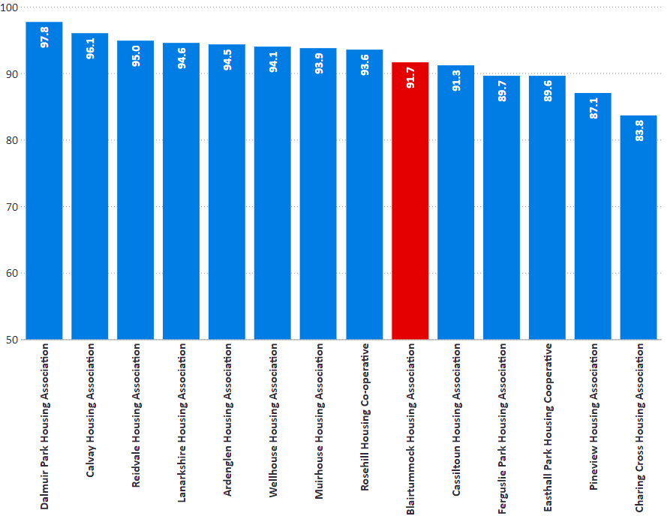
Overall Satisfaction
I1: Percentage of tenants satisfied with overall service.
% | 2018/19 | 2019/20 | 2020/21
Blairtummock HA | 97.0 | 91.7 | 91.7
Peer Groups | 92.3 | 91.9 | 92.4
All RSLs | 90.9 | 90.5 | 89.8
National Average | 90.1 | 89.2 | 89.0

Slide 8
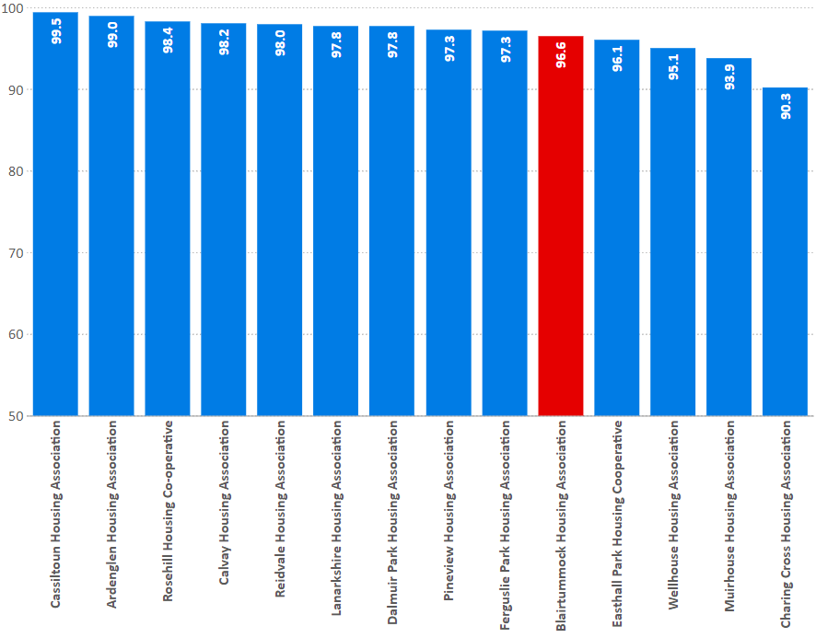
Kept Informed
I2: percentage of tenants who feel their landlord is good at keeping them informed about their services and outcomes
% | 2018/19 | 2019/20 | 2020/21
Blairtummock HA | 99.1 | 96.6 | 96.6
Peer Groups | 96.0 | 96.1 | 96.8
All RSLs | 93.5 | 93.1 | 92.8
National Average | 91.6 | 92.0 | 91.7

Slide 9
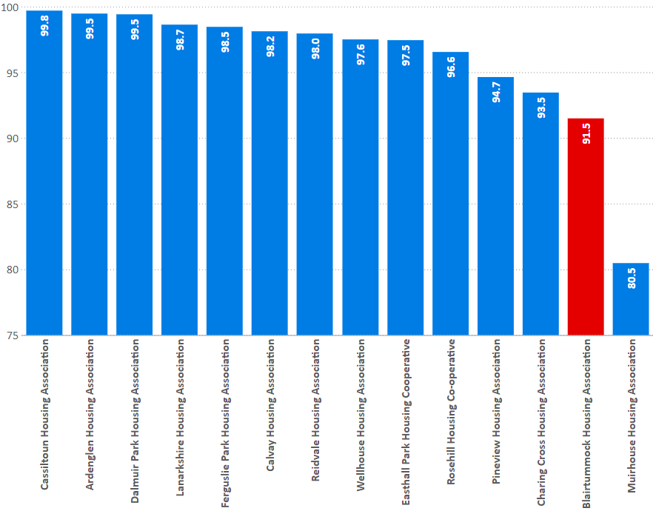
Opportunities to participate
I5: percentage of tenants satisfied with the opportunities given to them to participate in their landlord’s decision making processes
% | 2018/19 | 2019/20 | 2020/21
Blairtummock HA | 97.2 | 91.5 | 91.5
Peer Groups | 92.5 | 95.2 | 96.3
All RSLs | 88.2 | 88.6 | 87.9
National Average | 86.5 | 87.2 | 86.6

Slide 10
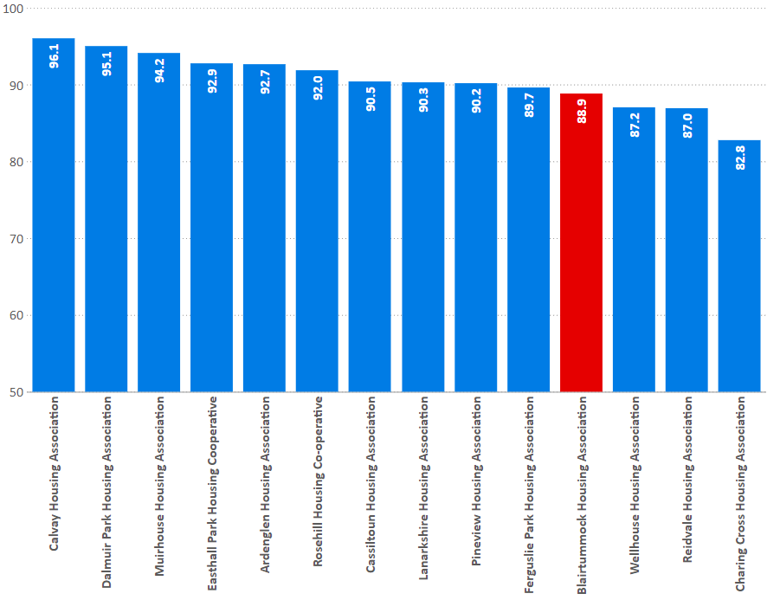
Quality of home (all tenants)
I7: percentage of existing tenants satisfied with the quality of their home.
% | 2018/19 | 2019/20 | 2020/21
Blairtummock HA | 96.4 | 88.9 | 88.9
Peer Groups | 90.0 | 90.3 | 90.8
All RSLs | 88.7 | 88.4 | 87.8
National Average | 88.1 | 87.2 | 87.1

Slide 11
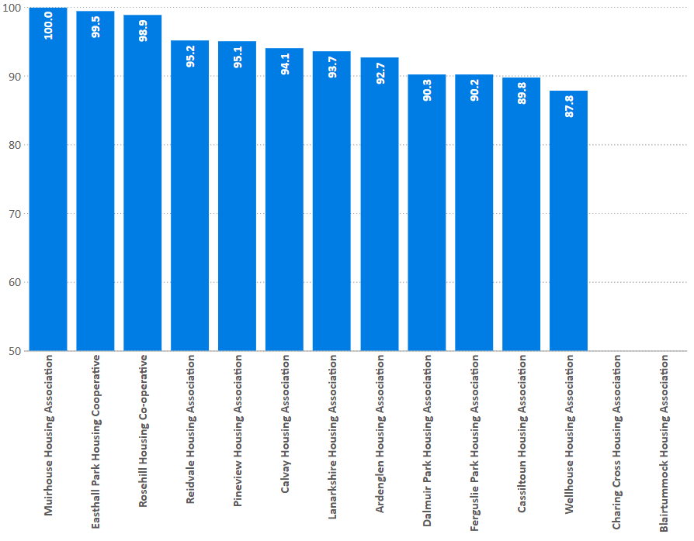
Repairs
I12: percentage of tenants who have had repairs or maintenance carried out in last 12 months satisfied with the repairs and maintenance service.
% | 2018/19 | 2019/20 | 2020/21
Blairtummock HA | 99.7 | 91.1 | -
Peer Groups | 95.0 | 93.1 | 93.9
All RSLs | 92.5 | 91.0 | 90.3
National Average | 91.7 | 90.8 | 90.1

Slide 12
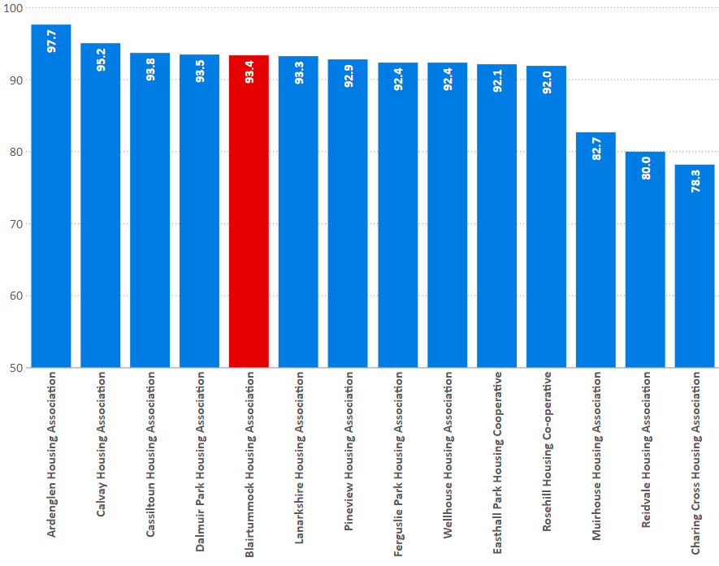
Management of neighbourhood
I13: Percentage of tenants satisfied with the management of the neighbourhood they live in
% | 2018/19 | 2019/20 | 2020/21
Blairtummock HA | 97.7 | 93.4 | 93.4
Peer Groups | 90.2 | 89.4 | 90.5
All RSLs | 88.4 | 87.8 | 86.6
National Average | 87.8 | 87.4 | 86.1

Slide 13
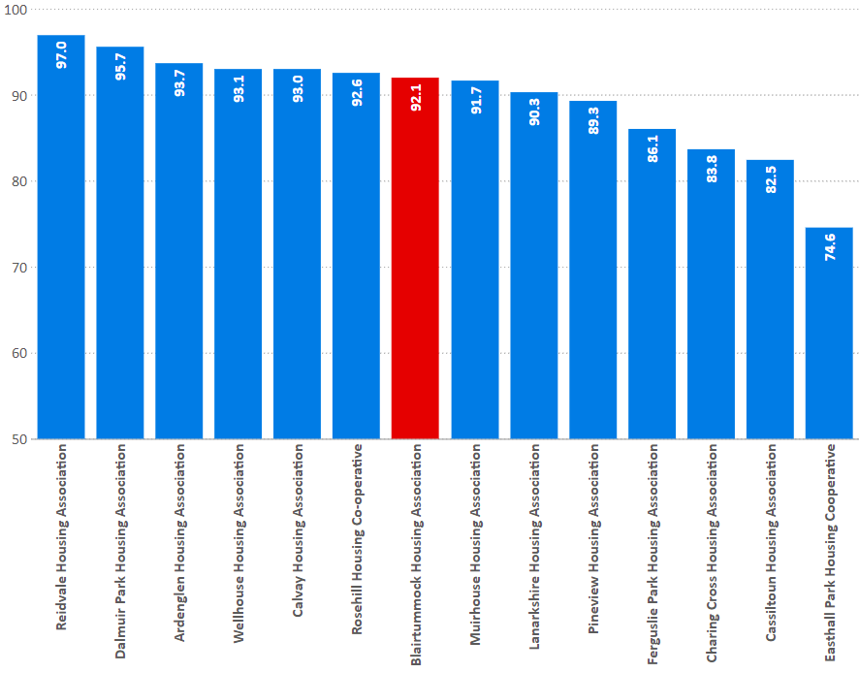
Value for money
I25: percentage of tenants who feel that the rent for their property represents good value for money.
% | 2018/19 | 2019/20 | 2020/21
Blairtummock HA | 91.3 | 92.1 | 92.1
Peer Groups | 87.2 | 88.8 | 89.5
All RSLs | 83.4 | 83.5 | 83.0
National Average | 83.2 | 83.6 | 82.8

Slide 14
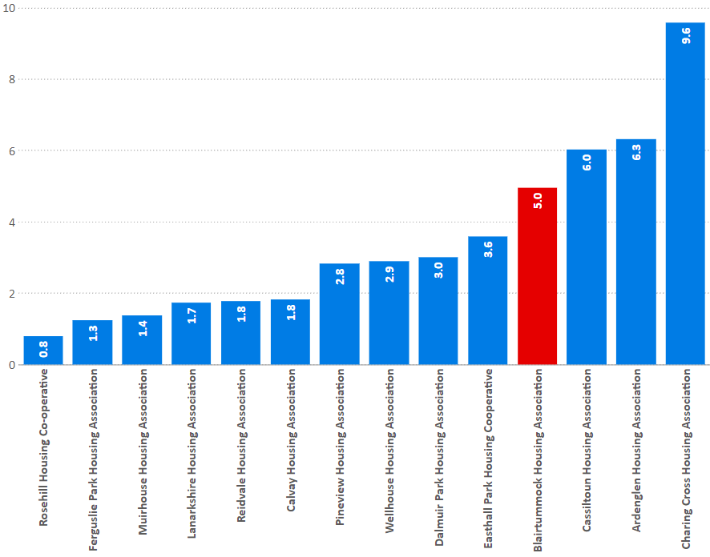
Complaints
I3: Complaints per 100 homes
% | 2018/19 | 2019/20 | 2020/21
Blairtummock HA | 9.7 | 6.8 | 5.0
Peer Groups | 4.4 | 5.8 | 3.3
All RSLs | 6.3 | 6.7 | 5.1
National Average | 4.7 | 5.1 | 3.7
I4: Time to respond to 1st & 2nd stage complaints
 | BlHA | RSL Average | National Average | SPSO Target
1st stage – days to respond | 1.1 | 3.8 | 5.4 | 5.0
2nd stage – days to respond | 6.7 | 16.6 | 19.3 | 20.0

Slide 15
Housing Quality & Maintenance

Slide 16
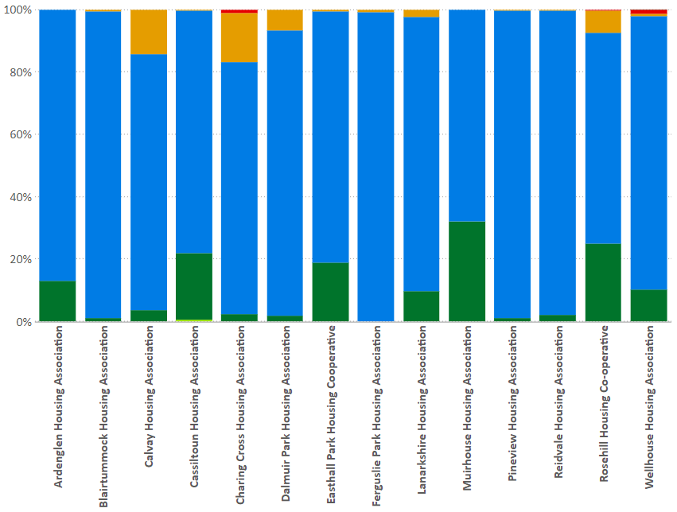
EESSH
Meeting EESSH: EPC: Percentage of stock with a valid EPC certificate within each band
%C or better
% | 2019/20 | 2020/21
Blairtummock HA | 99.0 | 99.3
Peer Groups | 95.7 | 95.9
All RSLs | 82.8 | 84.3
National Average | 73.0 | 74.0

Slide 17
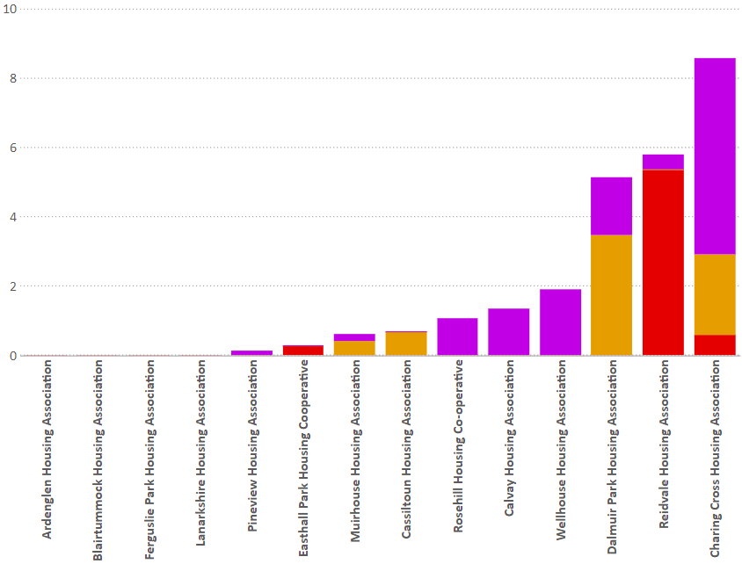
SHQS
Indicator 6: Percentage of stock meeting the Scottish Housing Quality Standard
Blairtummock HA | 2018/19 | 2019/20 | 2020/21
Meeting SHQS | 100.0 | 100.0 | 100.0
Exempt | 0.0 | 0.0 | 0.0
Abeyances | 0.0 | 0.0 | 0.0
Failing | 0.0 | 0.0 | 0.0
% | 2018/19 | 2019/20 | 2020/21
Blairtummock HA | 100.0 | 100.0 | 100.0
Peer Groups | 98.3 | 98.5 | 98.0
All RSLs | 93.0 | 92.9 | 90.5
National Average | 93.7 | 94.4 | 91.0

Slide 18
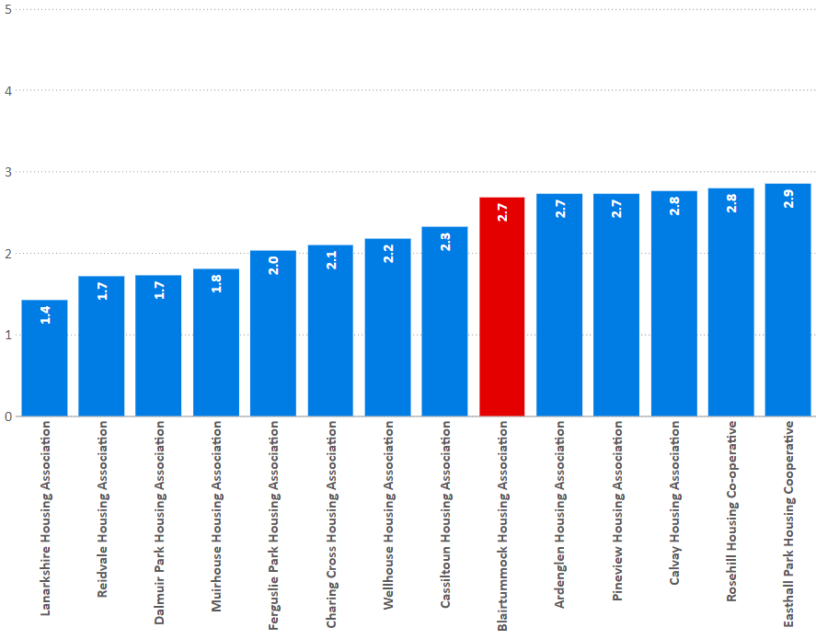
Emergency repairs
I8: Average length of time taken to complete emergency repairs (hours)
Hours | 2018/19 | 2019/20 | 2020/21
Blairtummock HA | 2.0 | 2.4 | 2.7
Peer Groups | 2.0 | 2.0 | 2.3
All RSLs | 2.7 | 2.6 | 3.4
National Average | 3.7 | 3.6 | 4.2

Slide 19
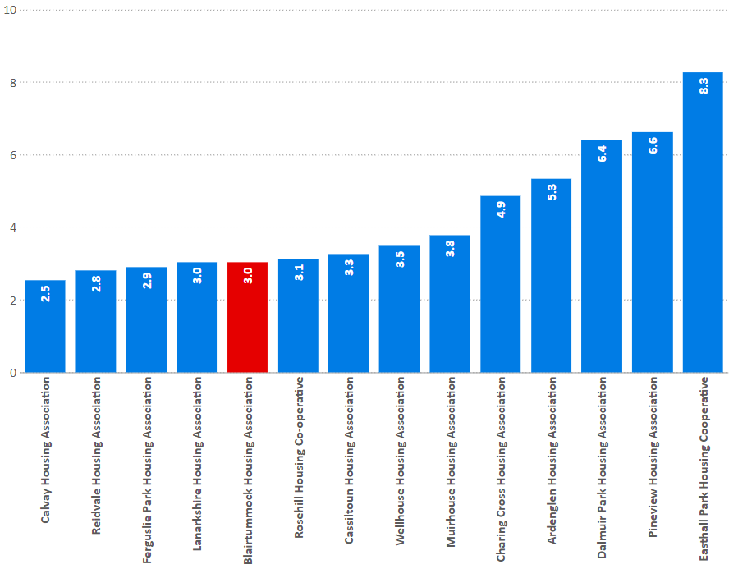
Non-emergency repairs
I9: Average length of time taken to complete non-emergency repairs (working days)
days | 2018/19 | 2019/20 | 2020/21
Blairtummock HA | 3.5 | 3.5 | 3.0
Peer Groups | 3.5 | 3.3 | 4.3
All RSLs | 5.5 | 5.7 | 6.7
National Average | 6.6 | 6.4 | 6.7

Slide 20
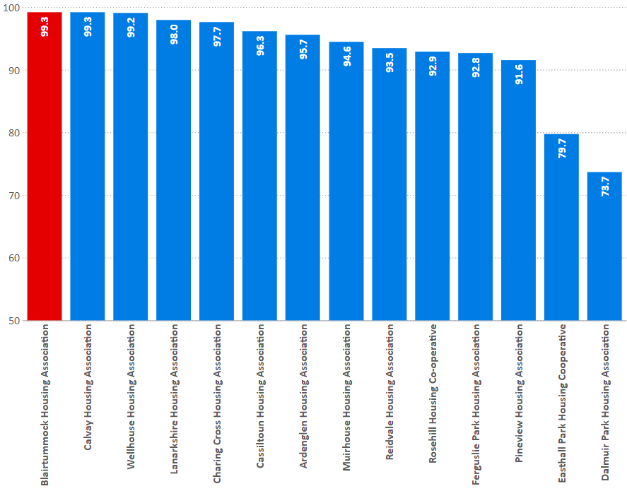
Repairs Right First Time
I10: Percentage of reactive repairs carried out in the last year completed right first time
% | 2018/19 | 2019/20 | 2020/21
Blairtummock HA | 96.9 | 97.1 | 99.3
Peer Groups | 94.0 | 95.5 | 92.7
All RSLs | 92.3 | 92.4 | 87.2
National Average | 92.5 | 92.4 | 91.5

Slide 21
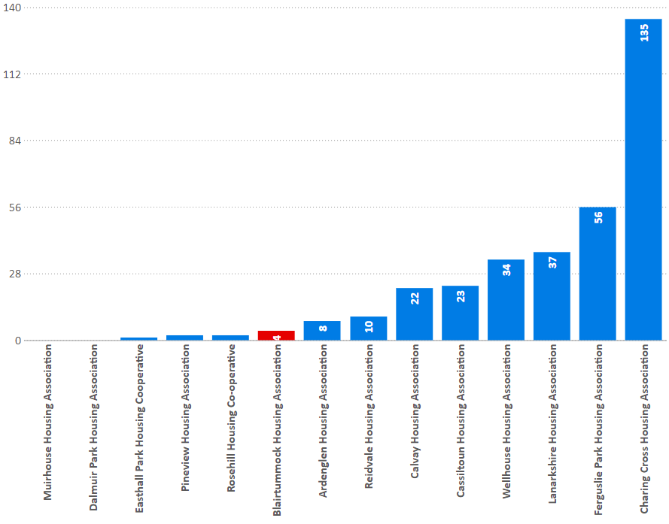
Gas safety
I11: Number of properties that failed to have a gas safety check and record completed by the anniversary date.
 | 2019/20 | 2020/21
Blairtummock HA | 0 | 4
Peer Groups | 5 | 330
All RSLs | 208 | 5513
SHN Total | 496 | 17420

Slide 22
Access

Slide 23
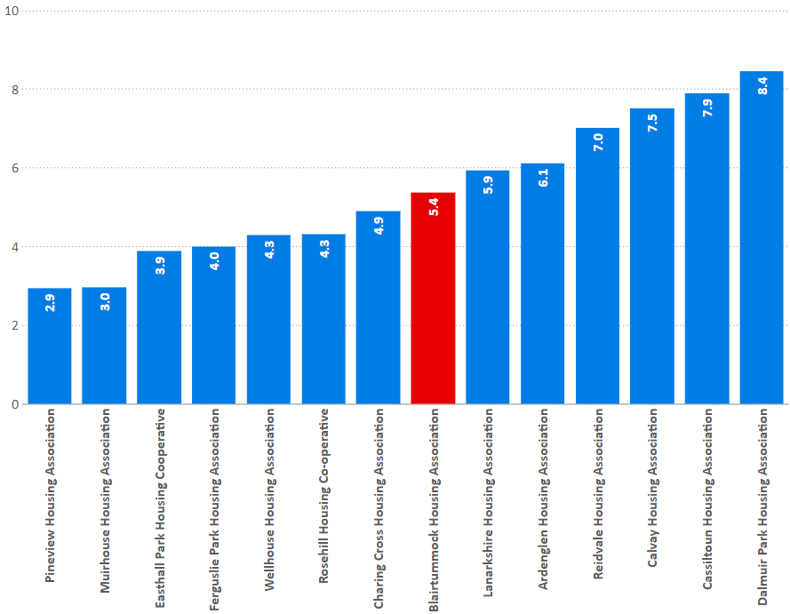
Turnover
I17: Percentage of lettable houses that became vacant in the last year.
% | 2018/19 | 2019/20 | 2020/21
Blairtummock HA | 4.7 | 4.5 | 5.4
Peer Groups | 6.5 | 6.5 | 5.4
All RSLs | 8.7 | 8.8 | 7.3
National Average | 8.6 | 8.4 | 7.0

Slide 24
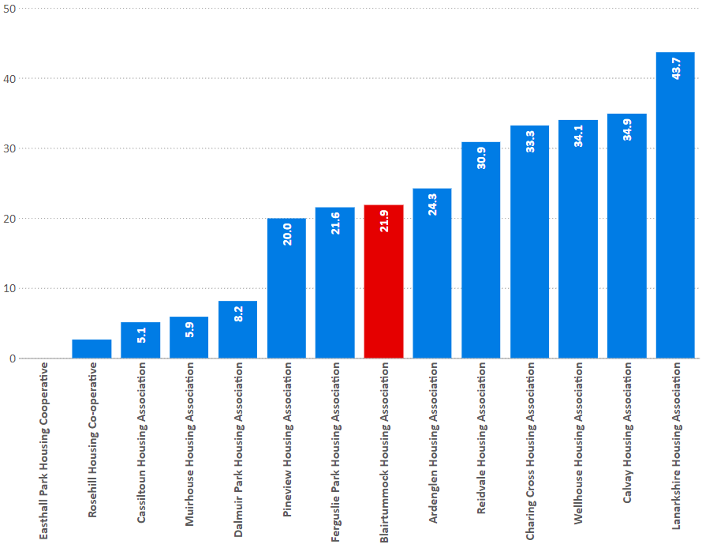
Offers refused
I14: Percentage of tenancy offers refused during the year.
% | 2018/19 | 2019/20 | 2020/21
Blairtummock HA | 39.0 | 20.6 | 21.9
Peer Groups | 23.2 | 24.2 | 20.4
All RSLs | 31.1 | 29.5 | 26.0
National Average | 36.3 | 34.2 | 31.9

Slide 25
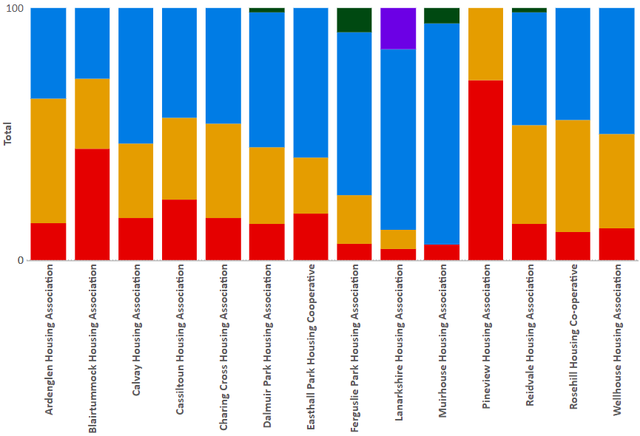
Lets by source
C2: The percentage of lets during the reporting year by source of let.
% | BlHA | All RSLs
Existing tenants | 44 | 14
Homeless applicants | 28 | 32
Housing list applicants | 28 | 46
Nomination | 0 | 4
Others | 0 | 3

Slide 26
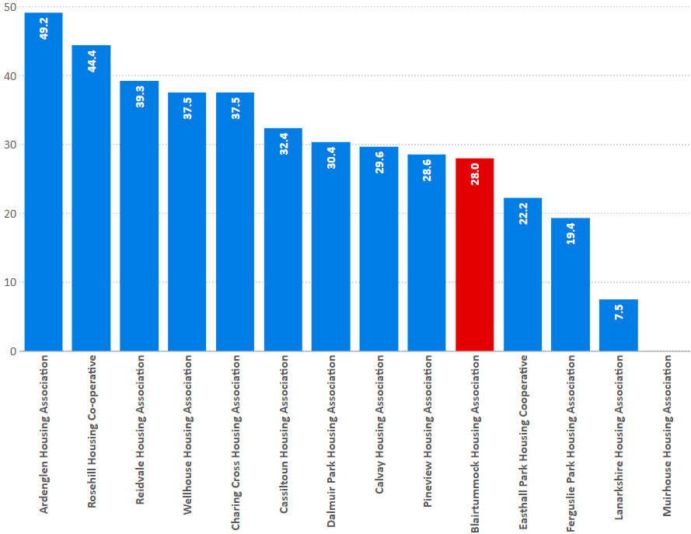
Lets to homeless
C2: The percentage of lets during the reporting year to tenants that have been assessed as statutorily homeless.
% | 2018/19 | 2019/20 | 2020/21
Blairtummock HA | 17.1 | 18.5 | 28.0
Peer Groups | 23.5 | 30.5 | 29.1
All RSLs | 23.7 | 25.4 | 32.4
National Average | 33.2 | 34.4 | 42.7

Slide 27
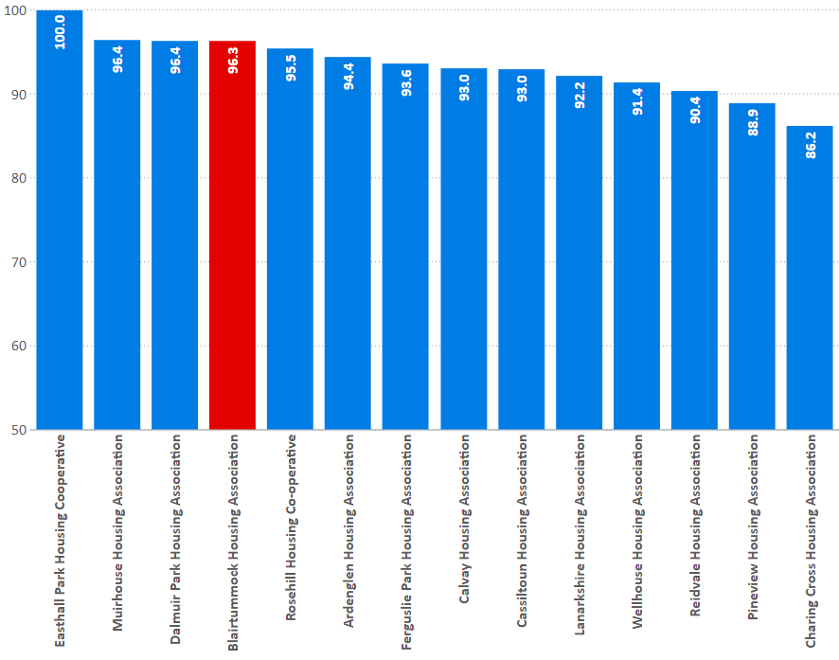
Tenancy sustainment
I16: Percentage of new tenancies sustained for more than a year; all sources of let.
% | 2018/19 | 2019/20 | 2020/21
Blairtummock HA | 93.1 | 97.1 | 96.3
Peer Groups | 94.6 | 92.4 | 93.2
All RSLs | 88.5 | 88.9 | 90.6
National Average | 88.8 | 89.1 | 90.9

Slide 28
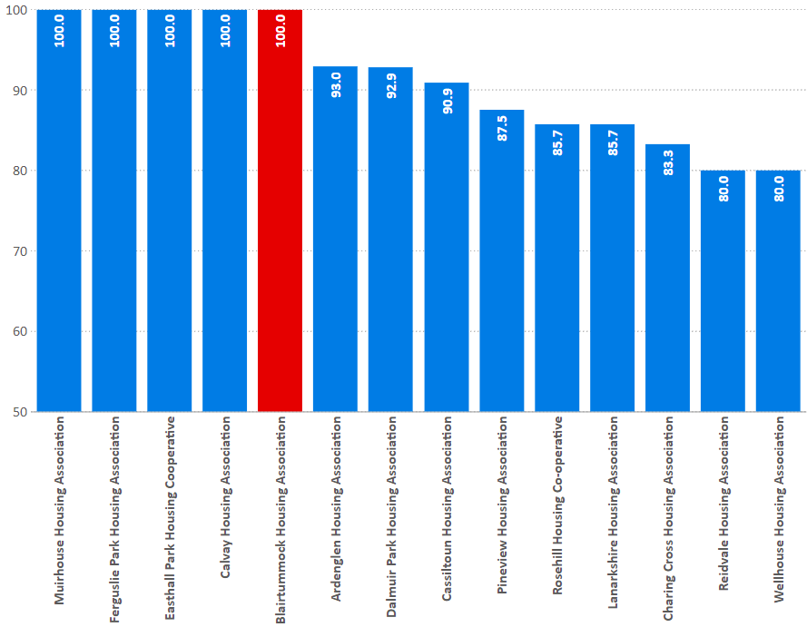
Tenancy sustainment (homeless)
I16: Percentage of new tenancies sustained for more than a year; statutory homeless.
% | 2018/19 | 2019/20 | 2020/21
Blairtummock HA | 100.0 | 100.0 | 100.0
Peer Groups | 93.4 | 87.6 | 90.7
All RSLs | 89.3 | 89.2 | 90.7
National Average | 87.9 | 88.1 | 90.2

Slide 29
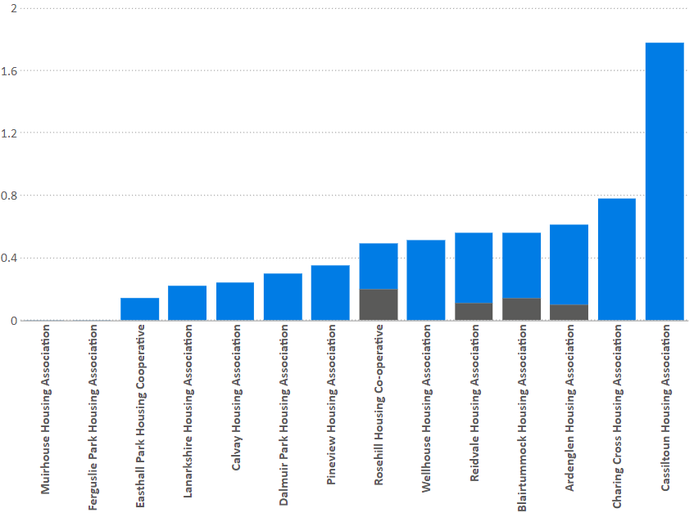
Evictions
I22: Evictions
Evictions as a percentage of stock
% | 2018/19 | 2019/20 | 2020/21
Blairtummock HA | 0.00 | 0.00 | 0.14
Peer Groups | 0.27 | 0.32 | 0.03
All RSLs | 0.33 | 0.27 | 0.03
National Average | 0.39 | 0.31 | 0.02
C4: Abandonments as a percentage of stock.
% | 2018/19 | 2019/20 | 2020/21
Blairtummock HA | 0.28 | 0.42 | 0.42
Peer Groups | 0.44 | 0.48 | 0.43
All RSLs | 0.56 | 0.54 | 0.36
National Average | 0.60 | 0.57 | 0.36
Notes:
Next we have the tenancies that ended negatively over the last year – so evictions and abandonments
Evictions are 0.14% of all stock
and abandonments are 0.42% of overall stock.

Slide 30
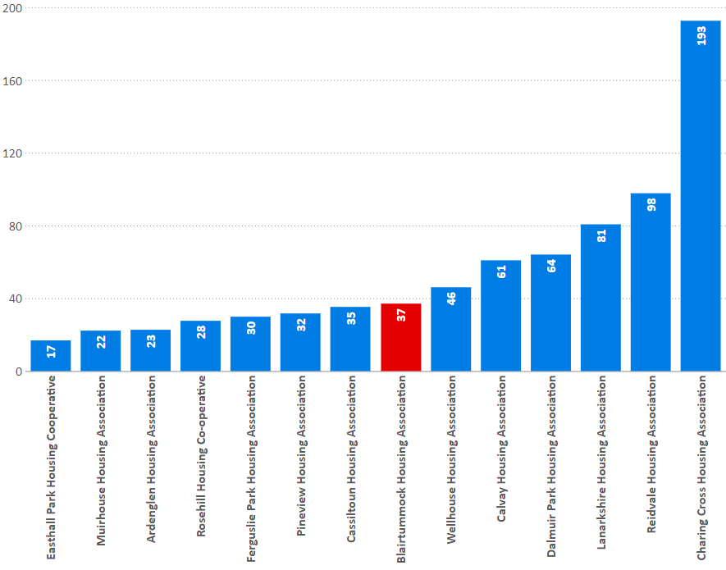
Medical adaptations
I21: The average time to complete medical adaptations during the reporting year.
(Calendar Days)
 | 2018/19 | 2019/20 | 2020/21
Blairtummock HA | 46.5 | 22.1 | 37.0
Peer Groups | 64.5 | 45.4 | 56.1
All RSLs | 58.3 | 50.4 | 71.4
National Average | 49.4 | 41.5 | 58.0
I21: Average cost for Blairtummock: £2,144
Peer Group: £2,499

Slide 31
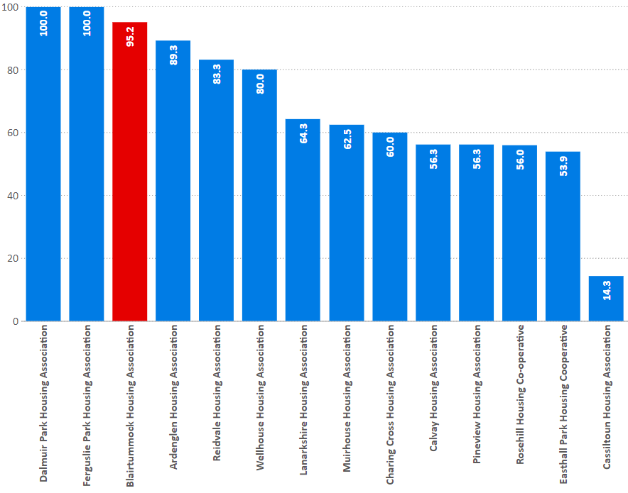
Medical adaptations
I19: Percentage of approved applications completed in year
(Calendar Days)
 | 2018/19 | 2019/20 | 2020/21
Blairtummock HA | 100.0 | 94.7 | 95.2
Peer Groups | 86.5 | 89.0 | 67.4
All RSLs | 83.7 | 82.2 | 75.9
National Average | 84.7 | 83.9 | 69.9

Slide 32
Rents

Slide 33
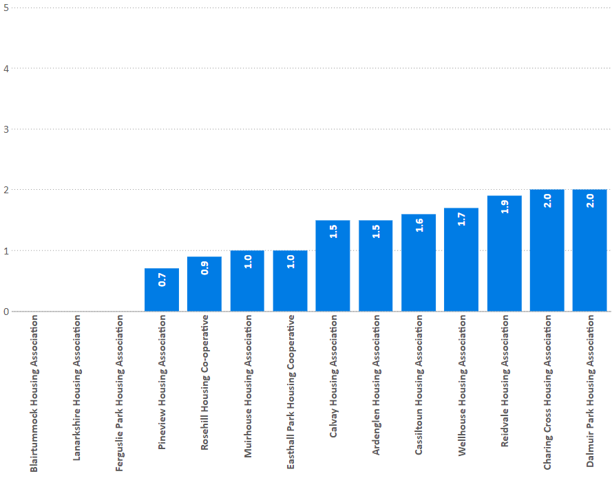
Rent collection
C5: Average change in weekly rent
% | 2018/19 | 2019/20 | 2020/21
Blairtummock HA | 2.5 | 0.0 | 0.0
Peer Groups | 3.0 | 2.3 | 1.2
All RSLs | 3.0 | 2.4 | 1.2
National Average | 3.0 | 2.5 | 1.2
C17: Average weekly rent
-3Apt
£ | 2018/19 | 2019/20 | 2020/21
Blairtummock HA | 69.58 | 71.37 | 72.62
Peer Groups | 75.40 | 76.79 | 79.31
All RSLs | 83.45 | 86.20 | 88.37
National Average | 77.70 | 80.11 | 82.67

Slide 34
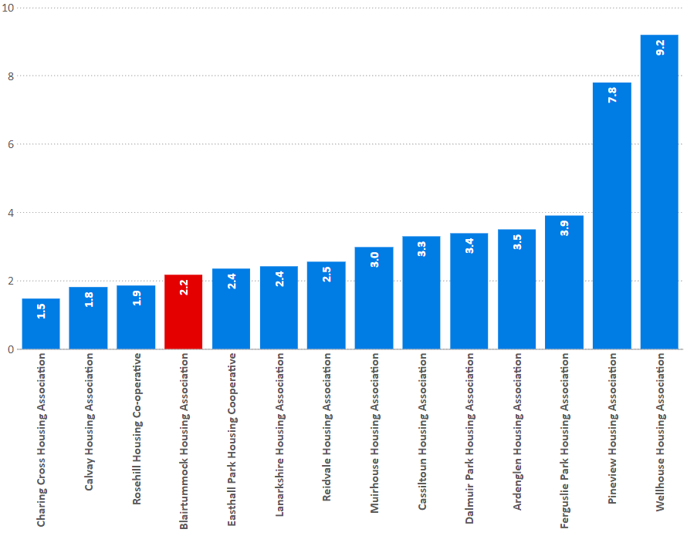
Arrears
I27: Current rent arrears (all tenants) as at 31 March each year as a percentage of rent due for the reporting year.
% | 2018/19 | 2019/20 | 2020/21
Blairtummock HA | 2.2 | 2.4 | 2.2
Peer Groups | 2.7 | 2.9 | 3.6
All RSLs | 2.8 | 3.0 | 3.0
National Average | 3.6 | 3.8 | 4.3

Slide 35
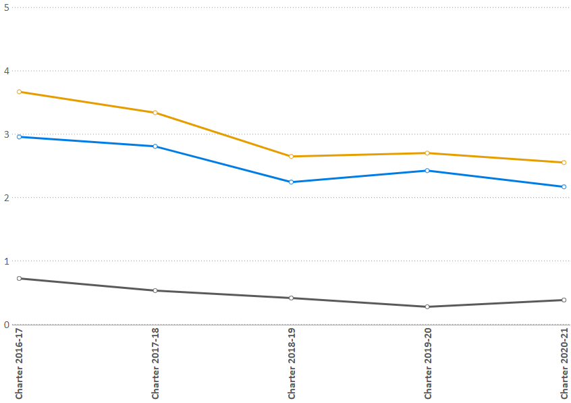
Arrears (trends)
I27: Gross Arrears trends
% | 2018/19 | 2019/20 | 2020/21
Blairtummock HA | 2.7 | 2.7 | 2.6
Peer Groups | 3.7 | 4.1 | 4.7
All RSLs | 4.2 | 4.4 | 4.2
National Average | 5.7 | 5.8 | 6.1

Slide 36
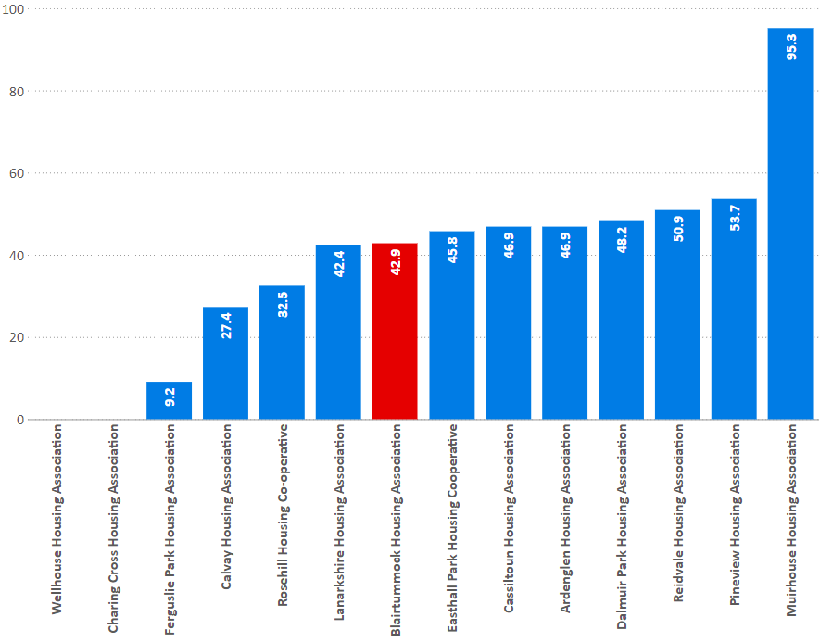
Arrears written off
C7: percentage of former tenant rent arrears written off at the year end.
% | 2018/19 | 2019/20 | 2020/21
Blairtummock HA | 53.7 | 15.3 | 42.9
Peer Groups | 44.0 | 37.2 | 38.4
All RSLs | 45.1 | 41.2 | 39.1
National Average | 37.9 | 34.4 | 31.9

Slide 37
Voids

Slide 38
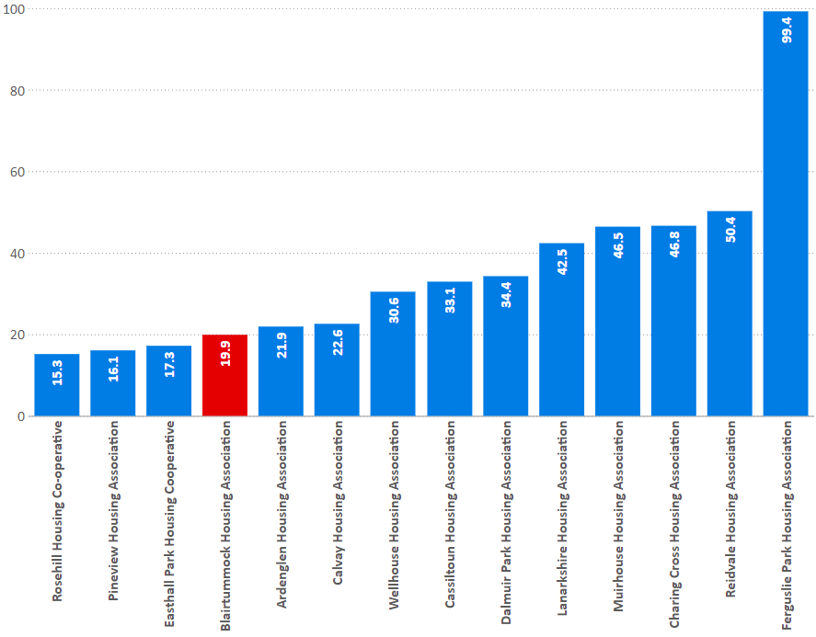
Relet times
I30: Average length of time taken to relet properties in the last year (calendar days)
% | 2018/19 | 2019/20 | 2020/21
Blairtummock HA | 11.6 | 10.3 | 19.9
Peer Groups | 11.5 | 10.9 | 36.7
All RSLs | 29.5 | 27.2 | 55.0
National Average | 31.9 | 31.5 | 56.3

Slide 39
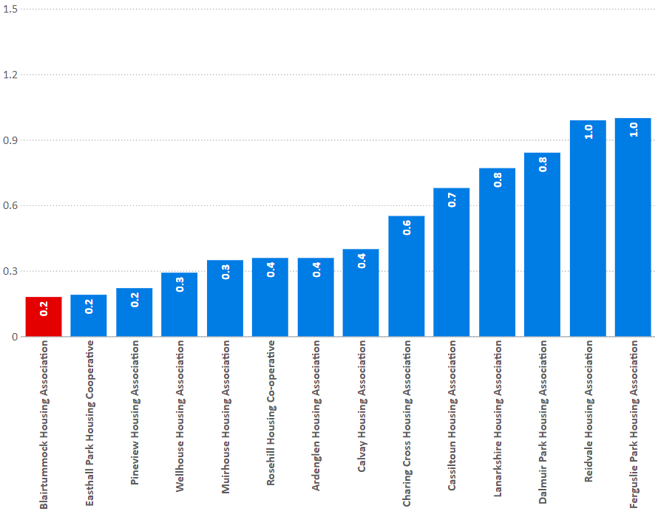
Void rent loss
I18: percentage of rent lost through properties being empty in the last year
% | 2018/19 | 2019/20 | 2020/21
Blairtummock HA | 0.1 | 0.1 | 0.2
Peer Groups | 0.2 | 0.2 | 0.5
All RSLs | 0.9 | 0.9 | 1.4
National Average | 0.9 | 0.9 | 1.4

Slide 40
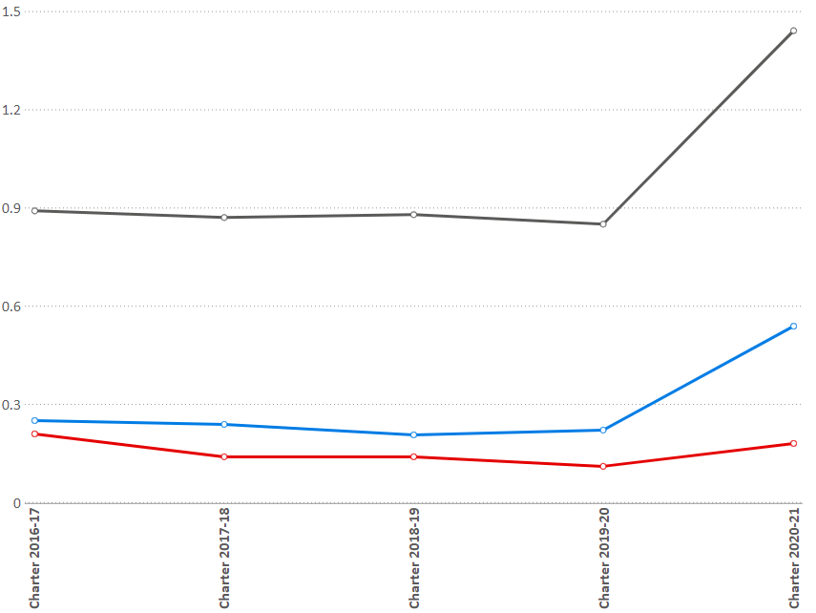
Void rent loss (trends)
I18: percentage of rent lost through properties being empty in the last year
% | 2018/19 | 2019/20 | 2020/21
Blairtummock HA | 0.1 | 0.1 | 0.2
Peer Groups | 0.2 | 0.2 | 0.5
All RSLs | 0.9 | 0.9 | 1.4
National Average | 0.9 | 0.9 | 1.4

Slide 41
Landlord Report
Service
Satisfaction:
Overall
Keeping informed
Opportunities to participate
SHQS
Emergency repairs time
Non-emergency repairs time
Right first time
Appointments kept
Repairs satisfaction
ASB cases within target
Value for Money
Average weekly rent
Annual rent increase
Void relet time
Void rent loss
Rent collected
Service and Value for Money
Landlord Report Indicators

Slide 42
Landlord Report
 | Overall satisfaction | Informed | Involved | SHQS | Emergency repairs | Non-emergency repairs | Right first time | Repairs satisfaction | Anti-social behaviour | Rent increase | Average rent 3-apt | Average rent - all | Rent collected | Void rent loss | Re-let time
Ardenglen Housing Association | 94.5 | 99.0 | 99.5 | 100.0 | 2.7 | 5.3 | 95.7 | 92.7 | 97.3 | 1.5 | 93.09 | 91.03 | 100.5 | 0.4 | 22
Blairtummock Housing Association | 91.70 | 96.60 | 91.51 | 100.00 | 2.69 | 3.04 | 99.30 | na | 100.00 | 0.00 | 75.26 | 76.13 | 95.21 | 0.18 | 19.88
Calvay Housing Association | 96.1 | 98.2 | 98.2 | 98.7 | 2.8 | 2.6 | 99.3 | 94.1 | 98.2 | 1.5 | 79.52 | 83.45 | 100.0 | 0.4 | 23
Cassiltoun Housing Association | 91.3 | 99.5 | 99.8 | 99.3 | 2.3 | 3.3 | 96.3 | 89.8 | 95.8 | 1.6 | 80.17 | 72.47 | 98.8 | 0.7 | 33
Easthall Park Housing Cooperative | 89.6 | 96.1 | 97.5 | 99.7 | 2.9 | 8.3 | 79.7 | 99.5 | 100.0 | 1 | 84.6 | 86.53 | 98.7 | 0.2 | 17
Ferguslie Park Housing Association | 89.7 | 97.3 | 98.5 | 100.0 | 2.0 | 2.9 | 92.7 | na | 96.9 | 0 | 82.18 | 80.68 | 99.7 | 1.0 | 99
Muirhouse Housing Association | 93.9 | 93.9 | 80.5 | 99.4 | 1.8 | 3.8 | 94.6 | 100.0 | 100.0 | 1 | 90.2 | 91.23 | 99.7 | 0.4 | 47
Pineview Housing Association | 87.1 | 97.3 | 94.7 | 99.9 | 2.7 | 6.6 | 91.6 | 95.1 | 97.3 | 0.7 | 87.59 | 93.52 | 99.4 | 0.2 | 16
Notes:
Heatmap for LAs

Slide 43
Landlord Report
Service v Value for money
Comparison with Peer group
Notes:
Service v VFM

Slide 44
Forums & Services
Forums
Asset Management
Homelessness and Housing Support
Housing Management
Local Housing Strategy
Private Sector Service
Service Improvement and Scrutiny
Services
Data Collection and Management
Practice Exchange
Private Sector Service
Tools
- Value for money model
- Value for money of new build projects
Online self-assessment
Training
Enhanced Service
Data accuracy and validation services
Business Plan Review and Performance Management Service

Slide 45
Overall summary - 2021
No new tenant satisfaction survey
EESSH – 99.3%
SHQS met
Repairs timescales remain strong, with 99.3% of repairs right first time
Tenancy turnover low, tenancy sustainment strong
Low rents, low rent arrears
Increase in void rent loss and days to let, below average

Slide 46
Scotland’s Housing Network
First floor, 19 Haymarket Yards
Edinburgh
EH12 5BH
T: 0131 466 3710
E: info@scotlandshousingnetwork.org
W: www.scotlandshousingnetwork.org
@ScotHousingNet
facebook.com/scotlandshousingnetwork
Linkedin.com – Scotland’s Housing Network

