Slide 1
Blairtummock
Housing Association
Performance analysis
4 September 2019
1

Slide 2
Key headlines for 2018-19
Stock numbers have risen above 600,000 for first time since 2007
Marked improvement in gas safety – 151, down by 608
There are about 1,000 more homeless lets than last year – 16,642 total
Rent arrears have risen for LA’s (+0.5%), but seem to have remained steady for RSL’s (-0.1%)
Overall satisfaction – LA’s, +0.8%, RSL’s, -0.1%
Sector headlines

Slide 3
Peer Group
1. Ardenglen Housing Association
2. Blairtummock Housing Association
3. Calvay Housing Association
4. Cassiltoun Housing Association
5. Charing Cross Housing Association
6. Dalmuir Park Housing Association
7. Easthall Park Housing Cooperative
8. Ferguslie Park Housing Association
9. Lanarkshire Housing Association
10. Muirhouse Housing Association
11. Pineview Housing Association
12. Reidvale Housing Association
13. Rosehill Housing Co-operative
14. Wellhouse Housing Association
15. Wishaw and District Housing Association

Slide 4
Method
Tenants surveyed: 529 (99 responses)
Method: face-to-face
Date: December 2016

Slide 5
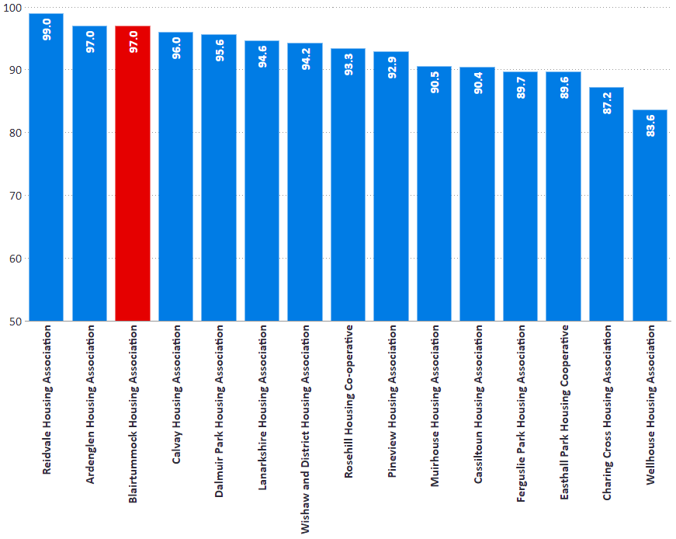
Overall Satisfaction
I1: Percentage of tenants satisfied with overall service.
% | 2016/17 | 2017/18 | 2018/19
Blairtummock | 97.0 | 97.0 | 97.0
Peer Group | 93.4 | 92.8 | 92.4
RSL Average | 91.1 | 91.7 | 90.9
SHR Average | 90.2 | 90.7 | 90.1

Slide 6
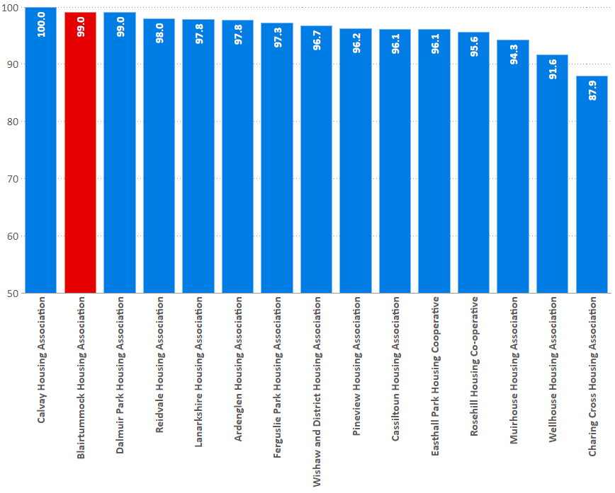
Kept Informed
I3: percentage of tenants who feel their landlord is good at keeping them informed about their services and outcomes
% | 2016/17 | 2017/18 | 2018/19
Blairtummock | 99.0 | 99.0 | 99.0
Peer Group | 96.3 | 95.3 | 96.0
RSL Average | 92.9 | 93.5 | 93.5
SHR Average | 91.1 | 92.2 | 91.6

Slide 7
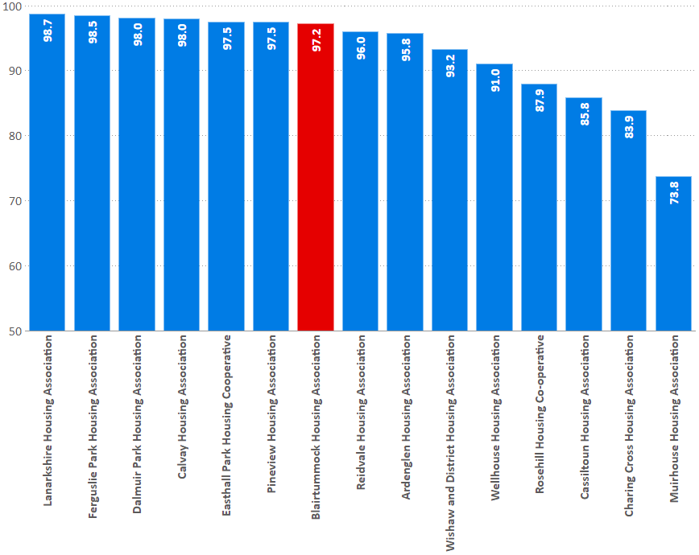
Opportunities to participate
I6: percentage of tenants satisfied with the opportunities given to them to participate in their landlord’s decision making processes
% | 2016/17 | 2017/18 | 2018/19
Blairtummock | 97.2 | 97.2 | 97.2
Peer Group | 91.8 | 90.8 | 92.5
RSL Average | 85.9 | 88.1 | 88.2
SHR Average | 83.8 | 86.4 | 86.5

Slide 8
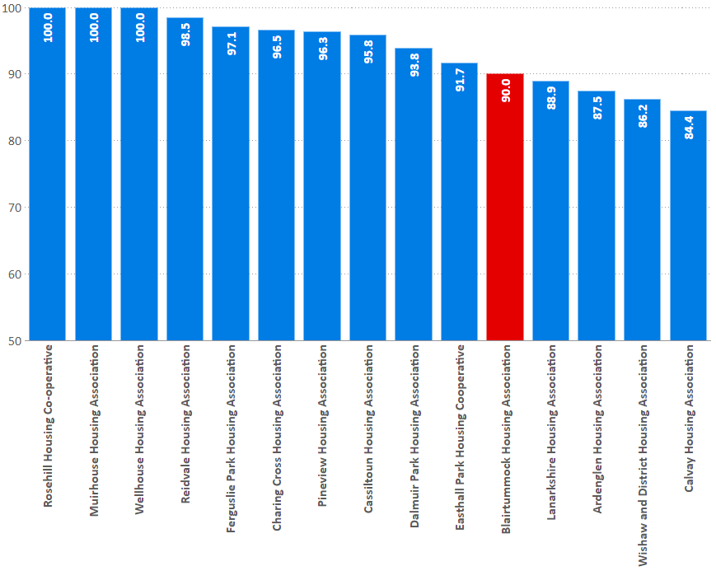
Standard of home when moving in
I9: percentage of tenants satisfied with the standard of their home when moving in
% | 2016/17 | 2017/18 | 2018/19
Blairtummock | 85.4 | 92.9 | 90.0
Peer Group | 90.0 | 93.4 | 94.1
RSL Average | 90.9 | 91.1 | 92.2
SHR Average | 90.0 | 90.2 | 90.8

Slide 9
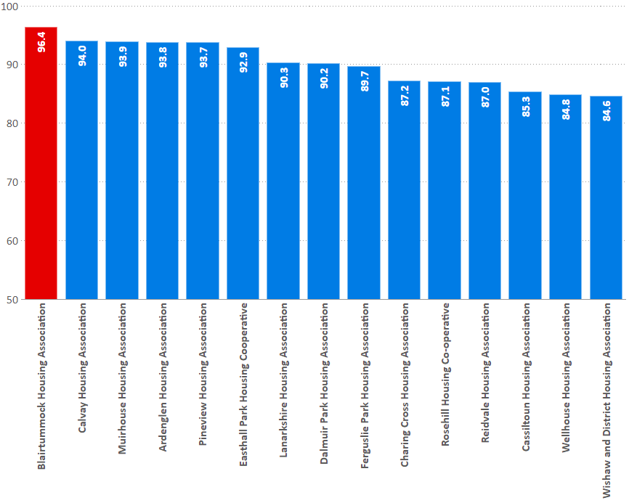
Quality of home (all tenants)
I10: percentage of existing tenants satisfied with the quality of their home.
% | 2016/17 | 2017/18 | 2018/19
Blairtummock | 96.4 | 96.4 | 96.4
Peer Group | 88.0 | 89.2 | 89.6
RSL Average | 88.0 | 89.1 | 88.7
SHR Average | 86.9 | 88.4 | 88.1

Slide 10
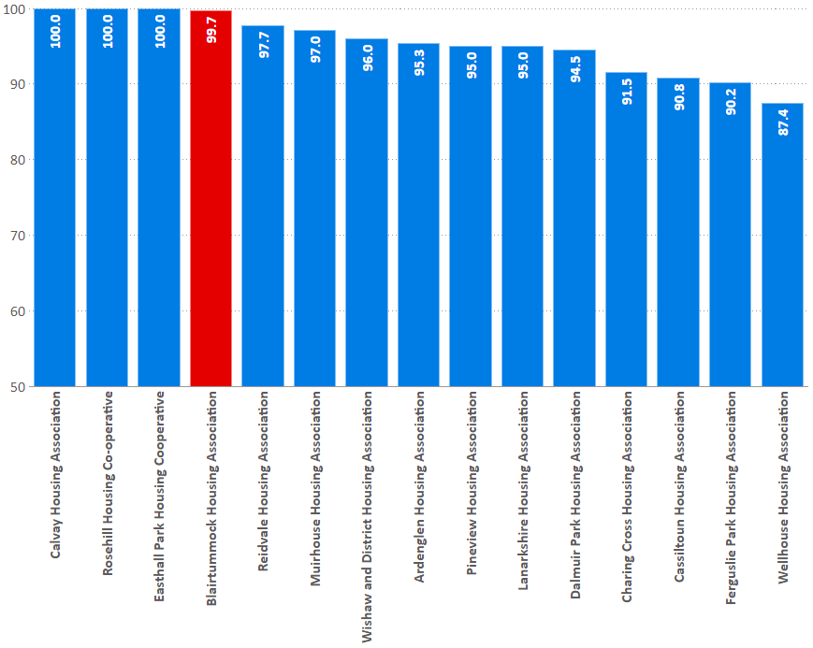
Repairs
I16: percentage of tenants who have had repairs or maintenance carried out in last 12 months satisfied with the repairs and maintenance service.
% | 2016/17 | 2017/18 | 2018/19
Blairtummock | 97.8 | 97.8 | 99.7
Peer Group | 92.7 | 94.6 | 95.0
RSL Average | 91.4 | 92.3 | 92.5
SHR Average | 90.6 | 92.1 | 91.7

Slide 11
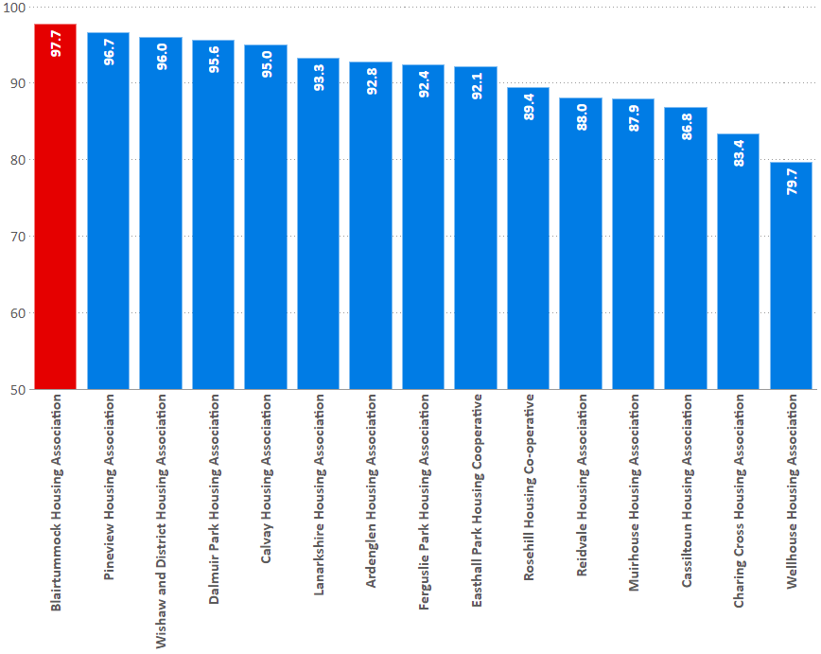
Management of neighbourhood
I17: Percentage of tenants satisfied with the management of the neighbourhood they live in
% | 2016/17 | 2017/18 | 2018/19
Blairtummock | 97.7 | 97.7 | 97.7
Peer Group | 89.9 | 90.4 | 90.6
RSL Average | 88.3 | 89.3 | 88.4
SHR Average | 87.1 | 88.5 | 87.8

Slide 12
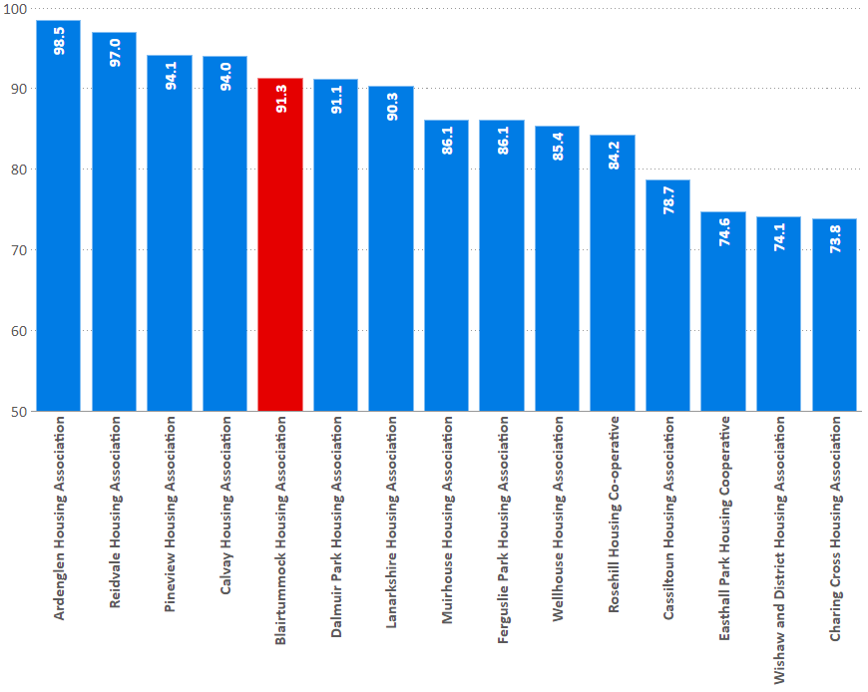
Value for money
I29: percentage of tenants who feel that the rent for their property represents good value for money.
% | 2016/17 | 2017/18 | 2018/19
Blairtummock | 91.3 | 91.3 | 91.3
Peer Group | 84.2 | 83.6 | 86.3
RSL Average | 82.6 | 83.9 | 83.4
SHR Average | 81.9 | 83.4 | 83.2

Slide 13
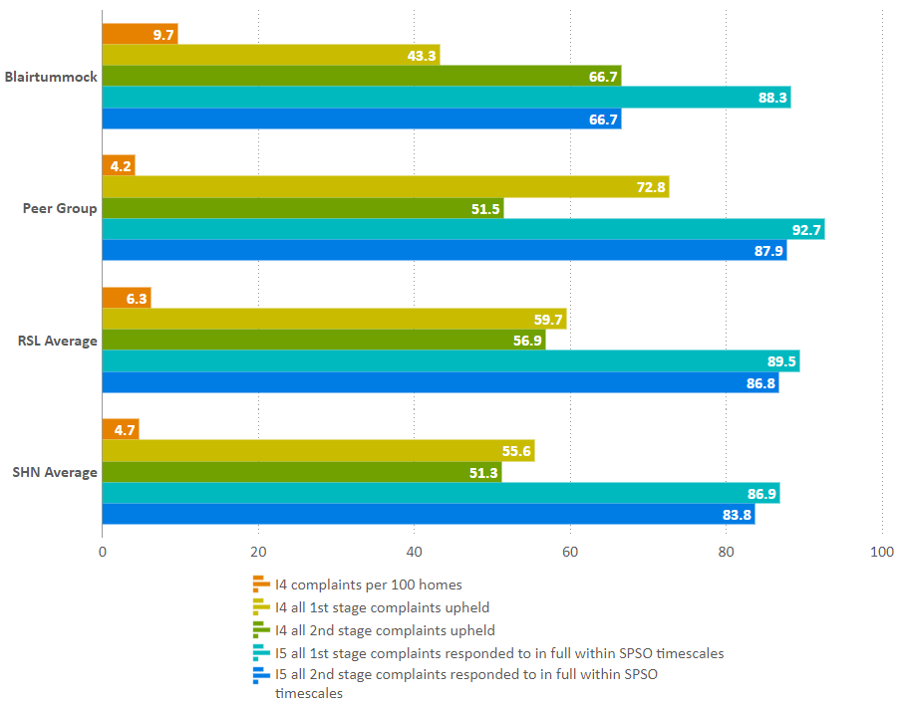
Complaints
I4&5: Percentage of 1st and 2nd stage complaints responded to in full in the last year, within the Scottish Public Services Ombudsman
 | BHA | Peer Group
Per 100 homes | 9.7 | 4.2
1st stage upheld | 43.3 | 72.8
2nd stage upheld | 66.7 | 51.5
1st stage on time | 88.3 | 92.7
2nd stage on time | 66.7 | 87.9

Slide 14
Housing Quality & Maintenance

Slide 15
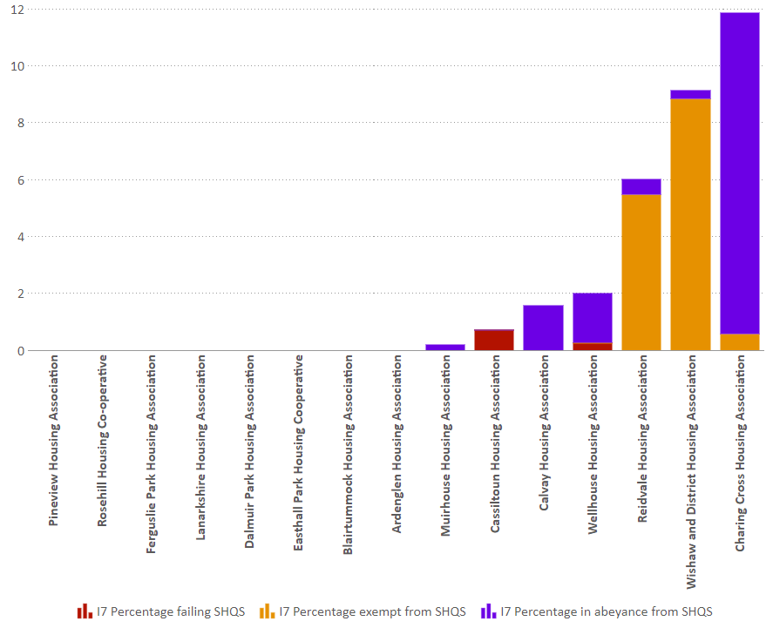
SHQS
Indicator 7: Percentage of stock meeting the Scottish Housing Quality Standard
Blairtummock | 2016/17 | 2017/18 | 2018/19
Meeting SHQS | 100.0 | 100.0 | 100.0
Exempt | 0.0 | 0.0 | 0.0
Abeyances | 0.0 | 0.0 | 0.0
Failing | 0.0 | 0.0 | 0.0
% | 2016/17 | 2017/18 | 2018/19
Blairtummock | 100.0 | 100.0 | 100.0
Peer Group | 97.2 | 97.2 | 97.8
RSL Average | 92.9 | 93.9 | 93.0
SHR Average | 93.6 | 94.2 | 94.1

Slide 16
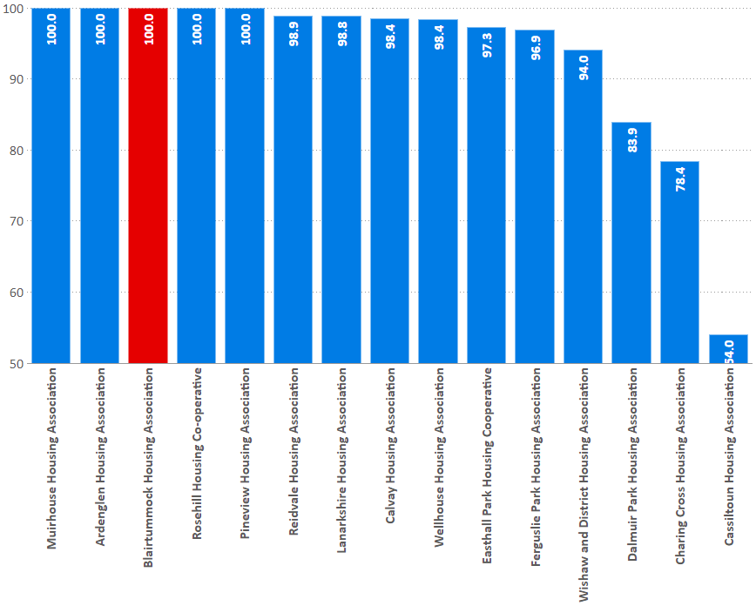
EESSH
C33: Percentage of houses meeting EESSH standard
C34: Projected to meet EESSH within year
% | 2016/17 | 2017/18 | 2018/19
Blairtummock | 90.9 | 99.7 | 100.0
Peer Group | 88.1 | 93.4 | 92.8
RSL Average | 75.5 | 83.0 | 86.9
SHR Average | 74.5 | 79.9 | 84.5

Slide 17
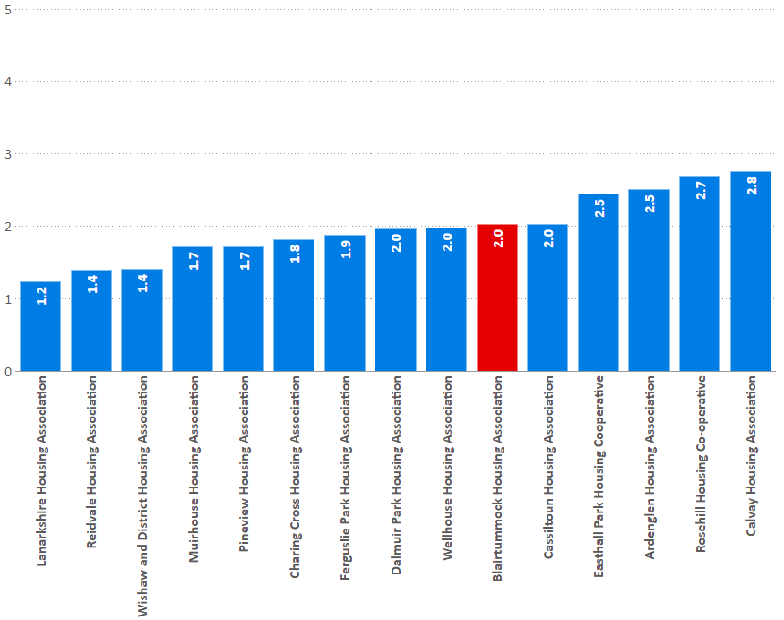
Emergency repairs
I11: Average length of time taken to complete emergency repairs (hours)
Hours | 2016/17 | 2017/18 | 2018/19
Blairtummock | 2.4 | 2.3 | 2.0
Peer Group | 2.2 | 2.1 | 2.0
RSL Average | 3.5 | 2.9 | 2.7
SHR Average | 4.7 | 4.0 | 3.7

Slide 18
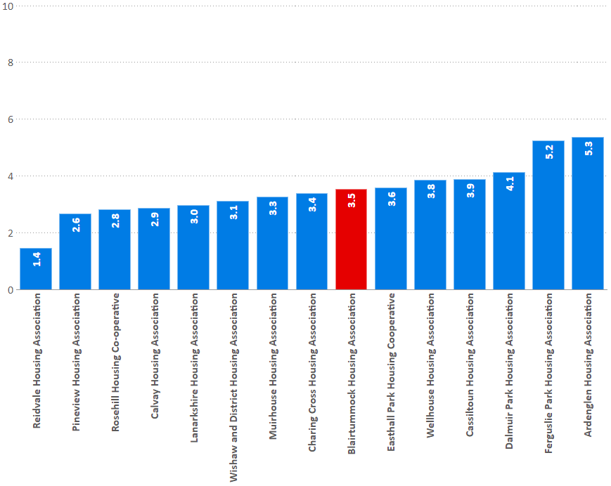
Non-emergency repairs
I12: Average length of time taken to complete non-emergency repairs (working days)
days | 2016/17 | 2017/18 | 2018/19
Blairtummock | 3.7 | 3.5 | 3.5
Peer Group | 3.2 | 3.4 | 3.5
RSL Average | 5.5 | 5.2 | 5.5
SHR Average | 7.1 | 6.4 | 6.6

Slide 19
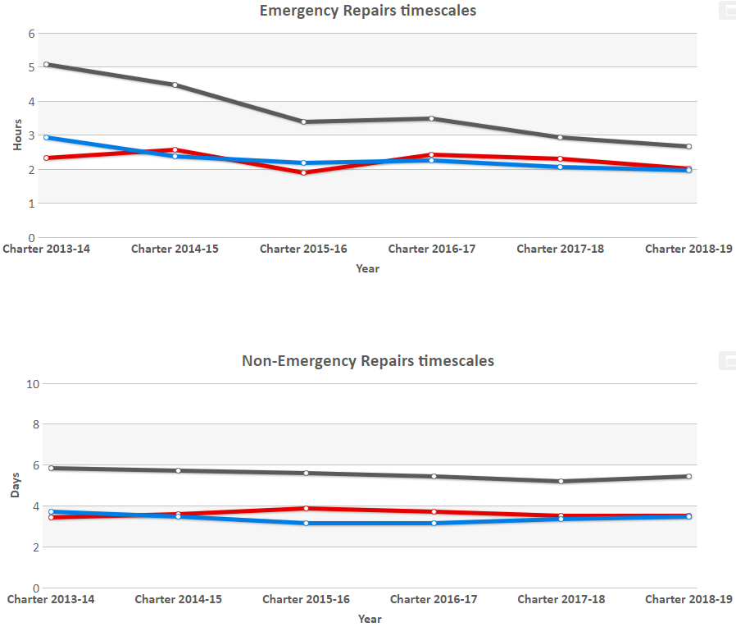
Repairs response times
Repair timescales:
Indicator 11 & 12 timescale trend comparison
hours | 2016/17 | 2017/18 | 2018/19
Blairtummock | 2.4 | 2.3 | 2.0
Peer Group | 2.2 | 2.1 | 2.0
RSL Average | 3.5 | 2.9 | 2.7
SHR Average | 4.7 | 4.0 | 3.7
days | 2016/17 | 2017/18 | 2018/19
Blairtummock | 3.7 | 3.5 | 3.5
Peer Group | 3.2 | 3.4 | 3.5
RSL Average | 5.5 | 5.2 | 5.5
SHR Average | 7.1 | 6.4 | 6.6

Slide 20
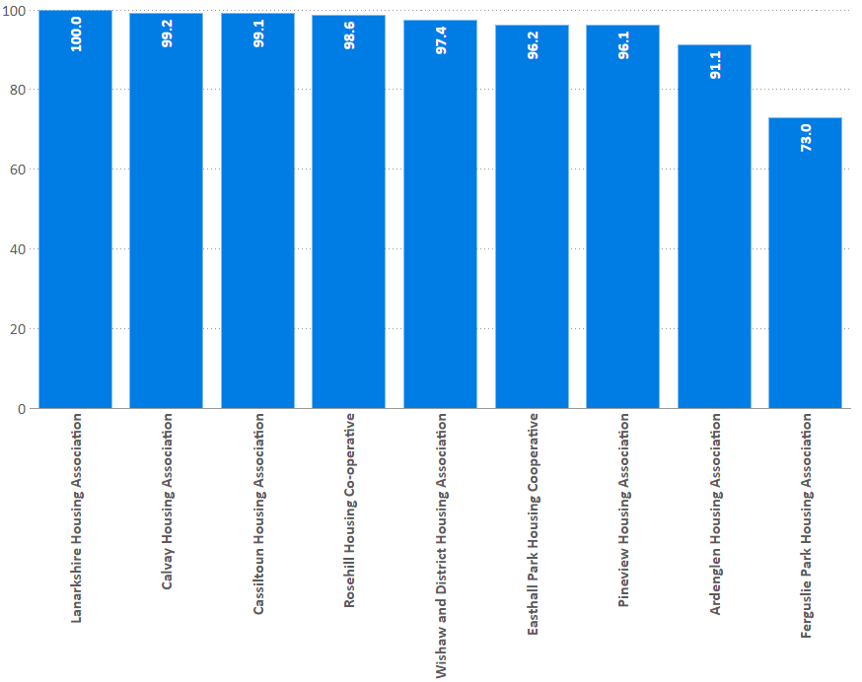
Repairs appointments
I14: Repairs appointment system - percentage of repairs appointments kept
% | 2016/17 | 2017/18 | 2018/19
Blairtummock | - | - | -
Peer Group | 98.4 | 98.1 | 94.5
RSL Average | 95.1 | 94.4 | 94.6
SHR Average | 95.7 | 95.5 | 95.6

Slide 21
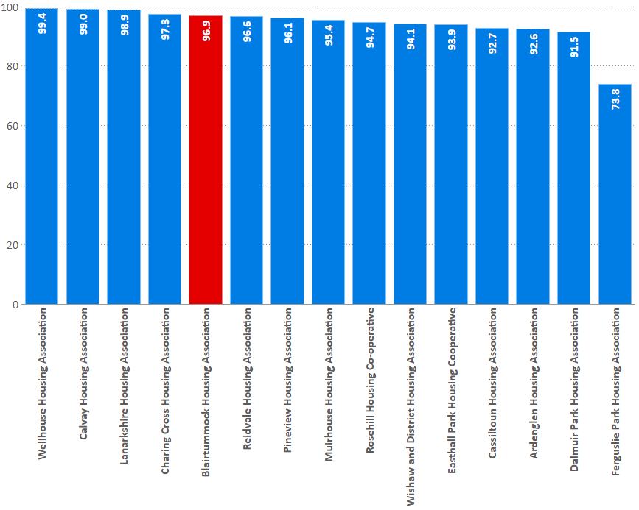
Repairs Right First Time
I13: Percentage of reactive repairs carried out in the last year completed right first time
% | 2016/17 | 2017/18 | 2018/19
Blairtummock | 87.5 | 96.7 | 96.9
Peer Group | 96.1 | 94.9 | 94.0
RSL Average | 92.1 | 91.5 | 92.3
SHR Average | 92.4 | 92.2 | 92.5

Slide 22
Repairs satisfaction
I16: percentage of tenants who have had repairs or maintenance carried out in last 12 months satisfied with the repairs and maintenance service.
% | 2016/17 | 2017/18 | 2018/19
Blairtummock | 97.8 | 97.8 | 99.7
Peer Group | 92.7 | 94.6 | 95.0
RSL Average | 91.4 | 92.3 | 92.5
SHR Average | 90.6 | 92.1 | 91.7

Slide 23
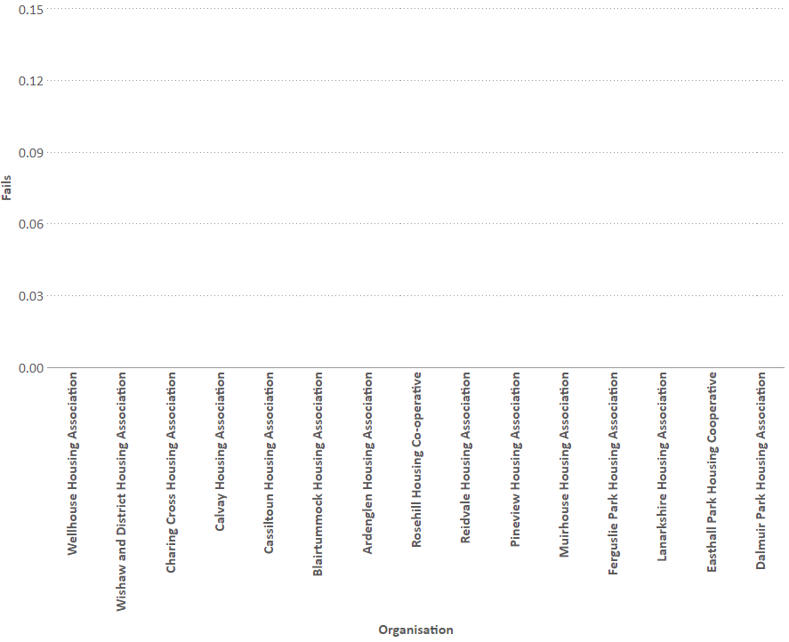
Gas safety
I15: Percentage of properties that require a gas safety record which had a gas safety check and record completed by the anniversary date.
% | 2016/17 | 2017/18 | 2018/19
Blairtummock | 100.0 | 100.0 | 100.0
Peer Group | 99.9 | 100.0 | 100.0
RSL Average | 99.9 | 99.9 | 99.9
SHR Average | 99.9 | 99.8 | 99.9
No. of fails | 2016/17 | 2017/18 | 2018/19
Blairtummock | 0 | 0 | 0

Slide 24
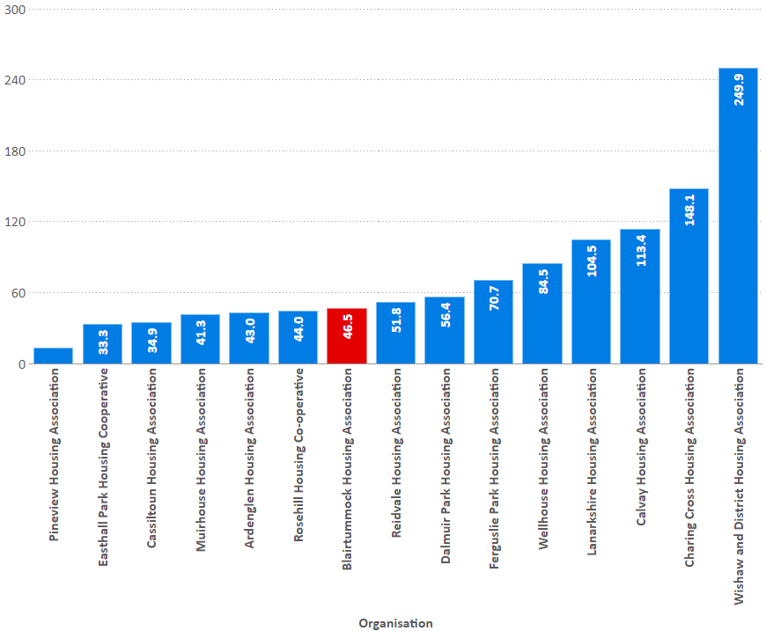
Medical adaptations
I23: The average time to complete medical adaptations during the reporting year.
Calendar Days | 2016/17 | 2017/18 | 2018/19
Blairtummock | 38.8 | 2.2 | 46.5
Peer Group | 88.2 | 74.4 | 77.8
RSL Average | 61.5 | 61.9 | 58.8
SHR Average | 48.5 | 48.1 | 49.4

Slide 25
Access
Housing lists & lets
General needs lets | 35
Supported housing lets | 0
Number of lets to existing tenants; | 16
Number of lets to housing list applicants; | 13
Number of mutual exchanges | 1
Number of lets from other sources | 0
Number of new applicants added | 328
Number of applicants at 31 March | 509
Number of suspensions | 9
Number of cancelled applications | 34
Own housing list
CHR | Yes
Choice based
Mutual exchange

Slide 26
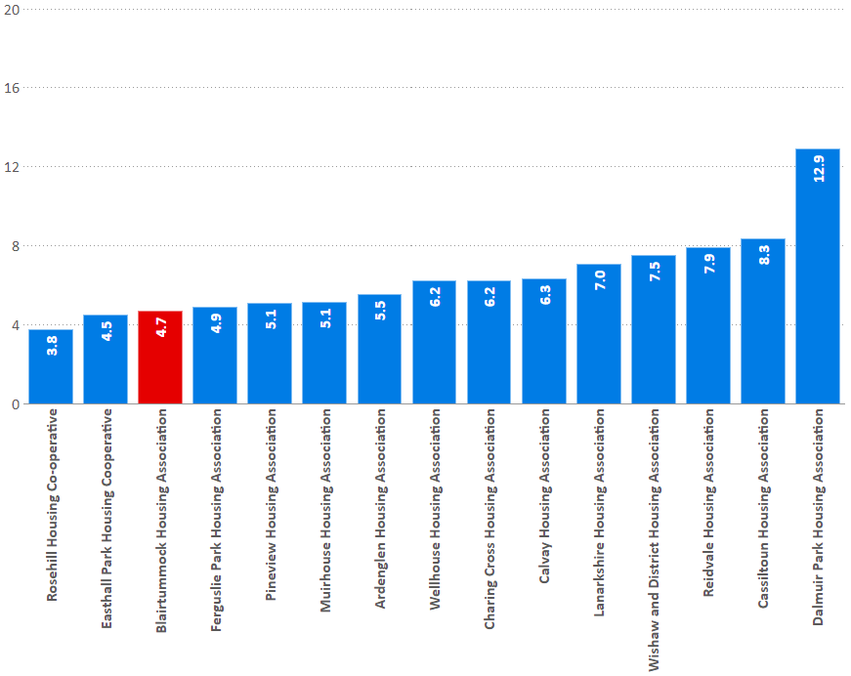
Turnover
I21: Percentage of lettable houses that became vacant in the last year.
% | 2016/17 | 2017/18 | 2018/19
Blairtummock | 5.7 | 3.9 | 4.7
Peer Group | 6.9 | 7.1 | 6.5
RSL Average | 8.8 | 8.8 | 8.7
SHR Average | 8.4 | 8.6 | 8.6

Slide 27
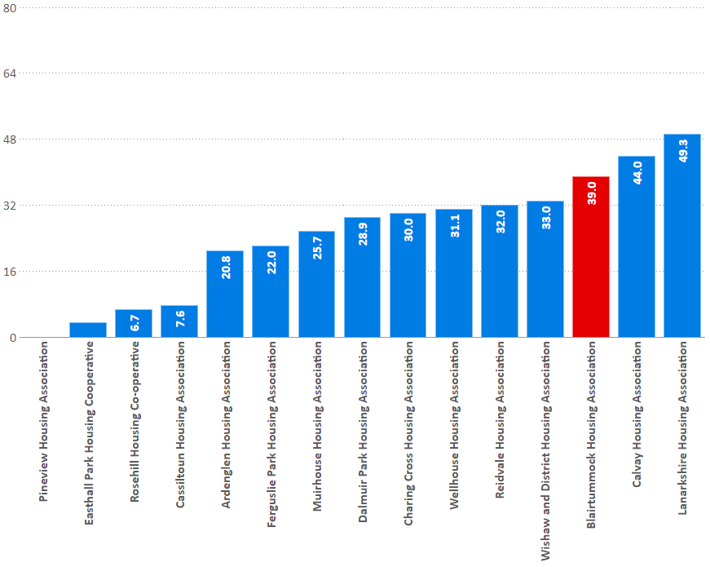
Offers refused
I18: Percentage of tenancy offers refused during the year.
% | 2016/17 | 2017/18 | 2018/19
Blairtummock | 26.4 | 35.9 | 39.0
Peer Group | 21.7 | 21.7 | 23.9
RSL Average | 32.8 | 30.8 | 31.1
SHR Average | 37.3 | 35.9 | 36.3

Slide 28
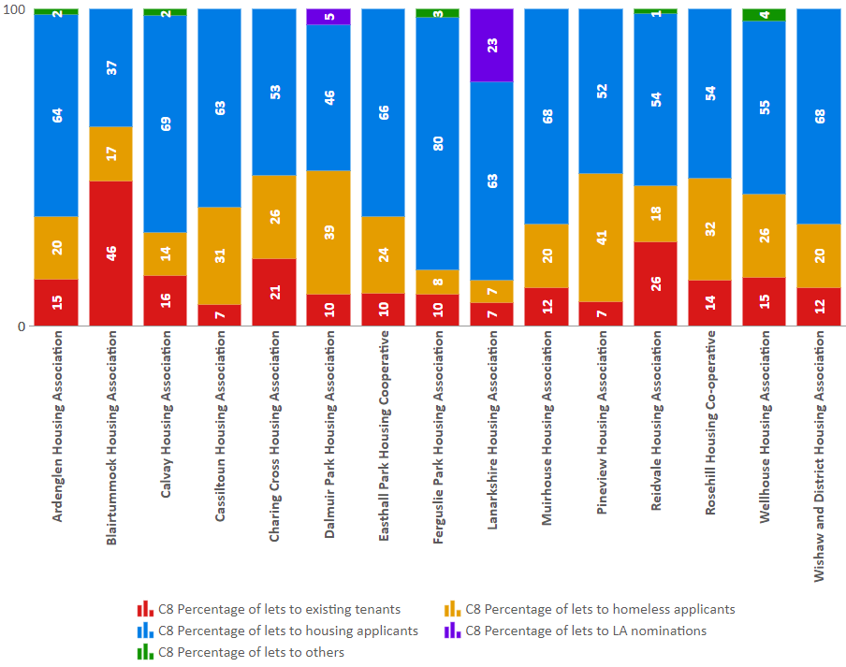
Lets by source
C8: The percentage of lets during the reporting year by source of let.
% | BHA | Peer Group | RSL Average
Existing tenants | 46 | 13 | 15
Homeless applicants | 17 | 23 | 25
Housing list applicants | 37 | 61 | 53
LA nomination | - | 2 | 3
Others | - | 1 | 3

Slide 29
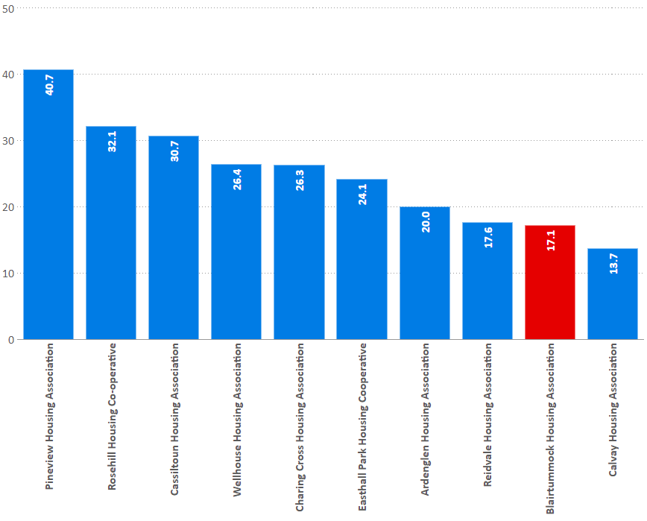
Lets to homeless
C8: The percentage of lets during the reporting year to tenants that have been assessed as statutorily homeless.
% | 2016/17 | 2017/18 | 2018/19
Blairtummock | 9.4 | 6.9 | 17.1
Peer Group | 20.7 | 21.5 | 23.3
RSL Average | 21.5 | 22.7 | 23.8
SHR Average | 31.4 | 32.9 | 33.2

Slide 30
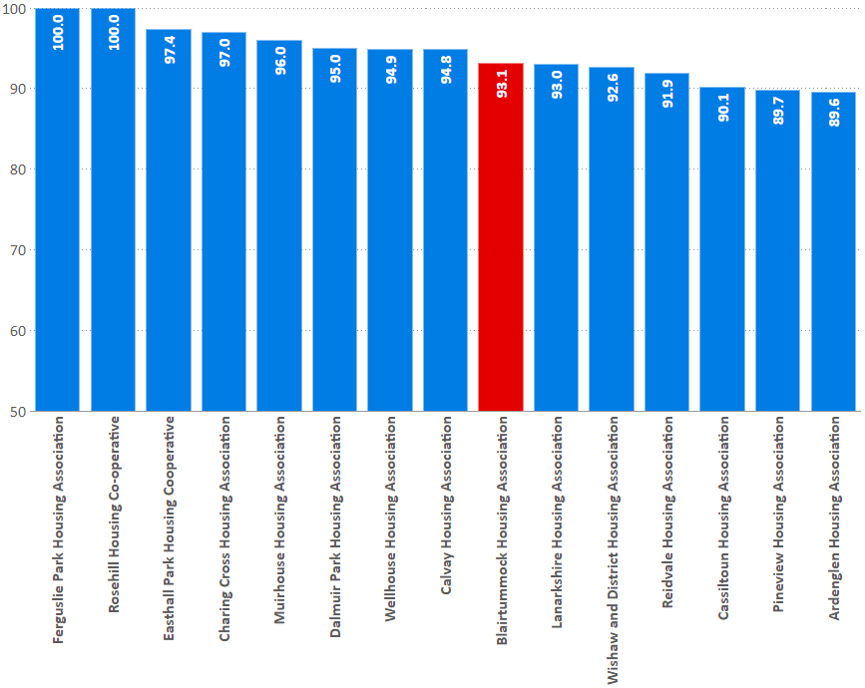
Tenancy sustainment
I20: Percentage of new tenancies sustained for more than a year; all sources of let.
% | 2016/17 | 2017/18 | 2018/19
Blairtummock | 94.6 | 93.0 | 93.1
Peer Group | 93.1 | 90.8 | 94.4
RSL Average | 88.5 | 88.2 | 88.5
SHR Average | 89.0 | 88.7 | 88.8

Slide 31
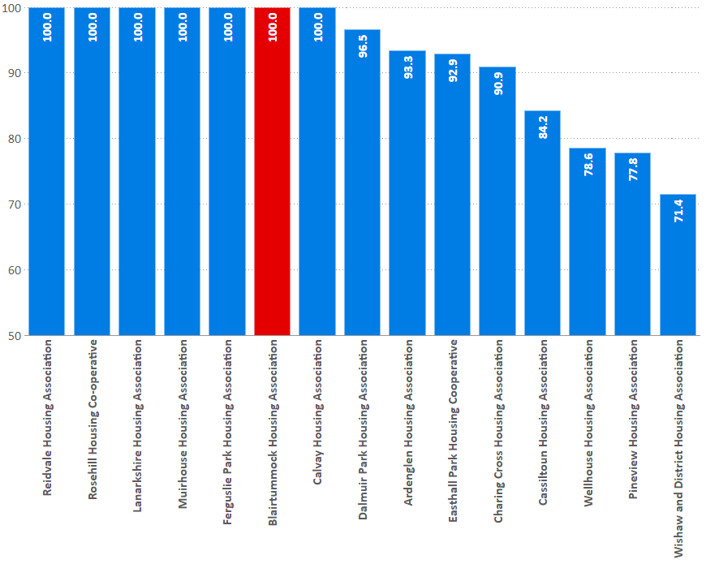
Tenancy sustainment (homeless)
I20: Percentage of new tenancies sustained for more than a year; statutory homeless.
% | 2016/17 | 2017/18 | 2018/19
Blairtummock | 100.0 | 80.0 | 100.0
Peer Group | 94.8 | 87.2 | 91.8
RSL Average | 89.2 | 89.7 | 89.3
SHR Average | 88.4 | 88.2 | 87.9

Slide 32
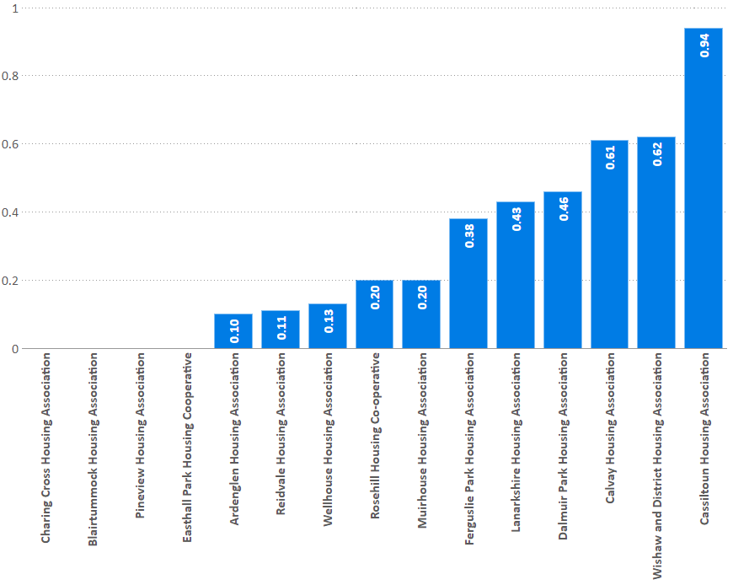
Evictions
I24: Evictions
Evictions as a percentage of stock
% | 2016/17 | 2017/18 | 2018/19
Blairtummock | 0.42 | 0.43 | 0.00
Peer Group | 0.22 | 0.17 | 0.30
RSL Average | 0.32 | 0.32 | 0.33
SHR Average | 0.39 | 0.38 | 0.39

Slide 33
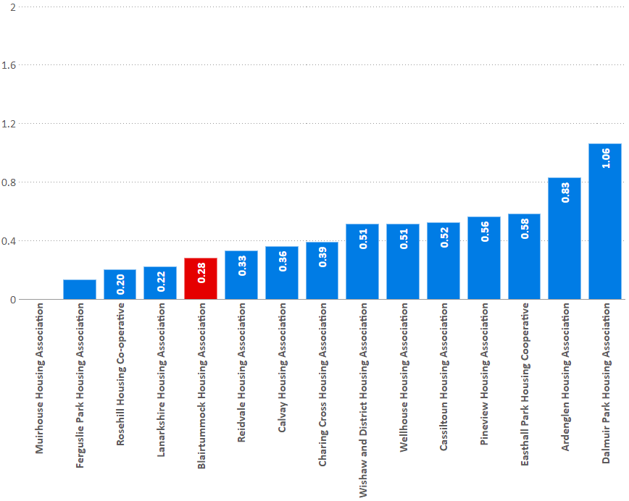
Abandonments
C11: Abandoned properties.
Abandonments as a percentage of stock.
% | 2016/17 | 2017/18 | 2018/19
Blairtummock | 0.28 | 0.43 | 0.28
Peer Group | 0.38 | 0.53 | 0.44
RSL Average | 0.54 | 0.52 | 0.55
SHR Average | 0.59 | 0.56 | 0.60

Slide 34
Rents

Slide 35
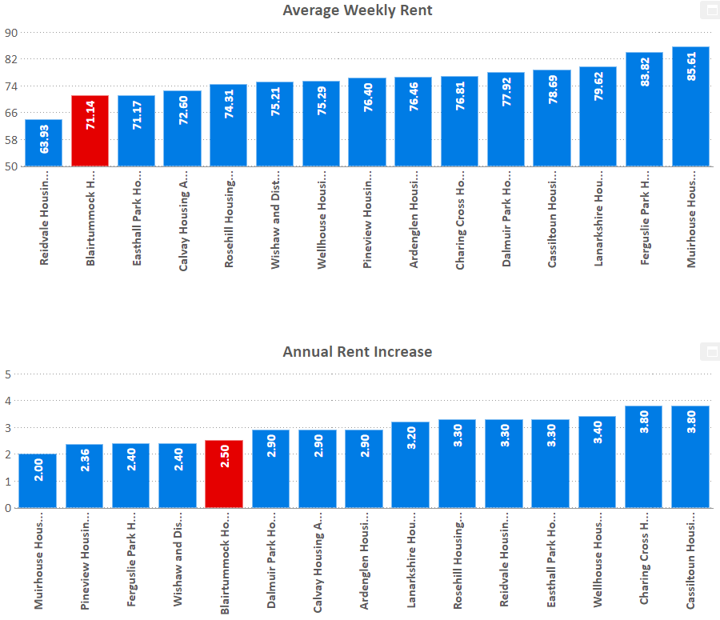
Rents
C17: Average weekly rent and rent increase
£ | 2016/17 | 2017/18 | 2018/19
Blairtummock | 67.69 | 69.06 | 71.14
Peer Group | 72.63 | 73.89 | 76.27
RSL Average | 80.37 | 82.59 | 85.45
SHR Average | 74.39 | 76.23 | 79.08
% | 2016/17 | 2017/18 | 2018/19
Blairtummock | 2.0 | 3.0 | 2.5
Peer Group | 2.0 | 3.2 | 3.0
RSL Average | 2.2 | 3.2 | 3.0
SHR Average | 2.3 | 3.2 | 3.0

Slide 36
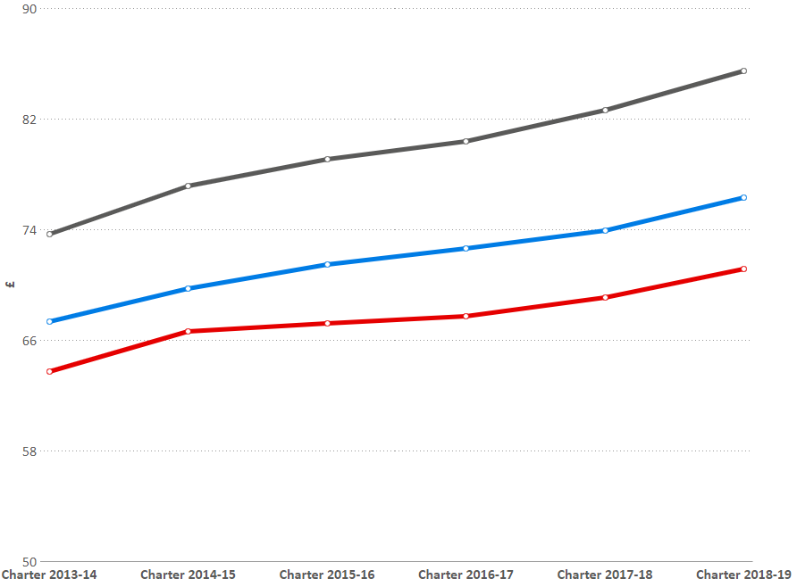
Rent increase (trends)
C21: Change in average rent
£ | 2016/17 | 2017/18 | 2018/19
Blairtummock | 67.69 | 69.06 | 71.14
Peer Group | 72.63 | 73.89 | 76.27
RSL Average | 80.37 | 82.59 | 85.45
SHR Average | 74.39 | 76.23 | 79.08
% | 2016/17 | 2017/18 | 2018/19
Blairtummock | 2.0 | 3.0 | 2.5
Peer Group | 2.0 | 3.2 | 3.0
RSL Average | 2.2 | 3.2 | 3.0
SHR Average | 2.3 | 3.2 | 3.0

Slide 37
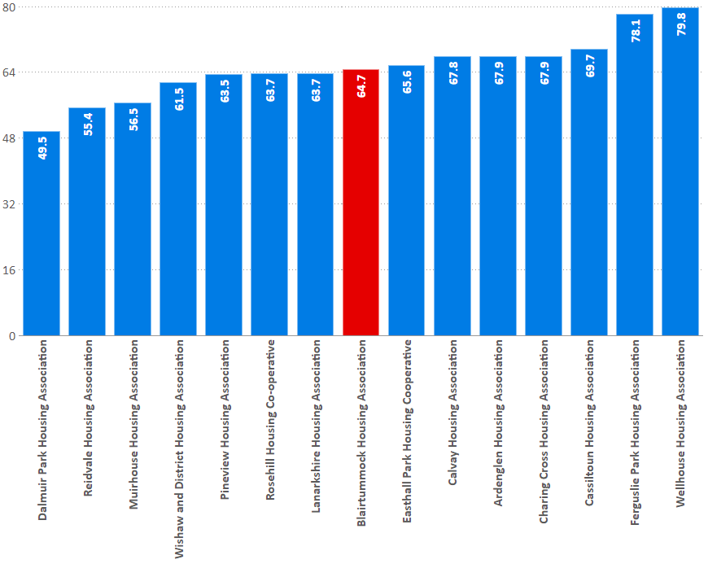
Direct housing costs
C22: Percentage of households for which landlords are paid housing costs directly
% | 2016/17 | 2017/18 | 2018/19
Blairtummock | 78.1 | 63.3 | 64.7
Peer Group | 66.5 | 69.8 | 65.0
RSL Average | 64.5 | 63.5 | 62.2
SHR Average | 68.1 | 67.2 | 64.9
Notes:
What about UC?

Slide 38
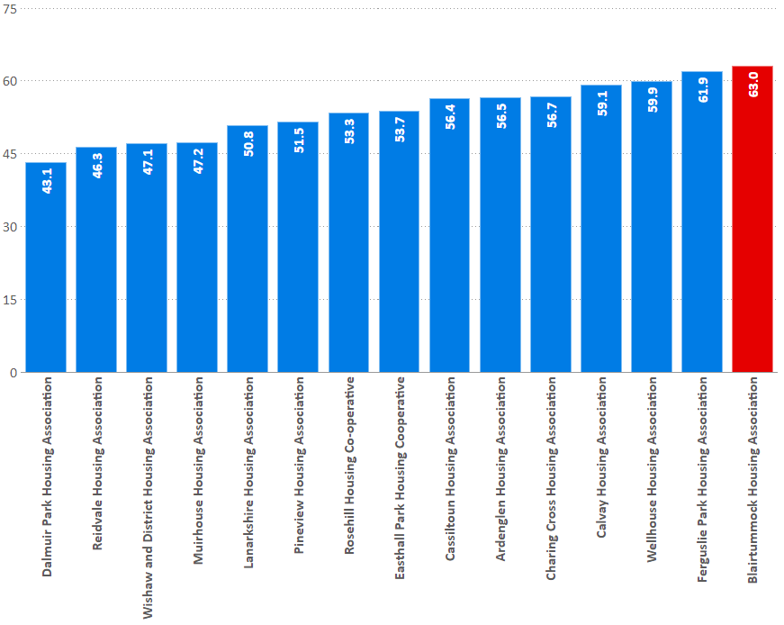
Direct housing costs
C22: Percentage value of the direct housing payments received in the reporting year.
% | 2016/17 | 2017/18 | 2018/19
Blairtummock | 61.1 | 61.2 | 63.0
Peer Group | 54.7 | 54.5 | 53.1
RSL Average | 53.2 | 52.0 | 50.3
SHR Average | 54.4 | 53.3 | 51.6

Slide 39
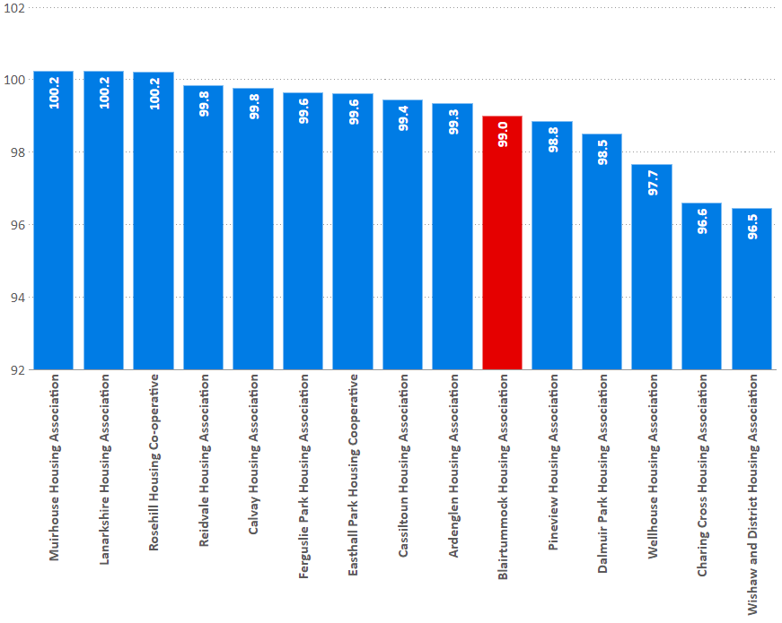
Rent collection
I30: Rent collected from tenants as a percentage of total rent due in the reporting year
% | 2016/17 | 2017/18 | 2018/19
Blairtummock | 99.2 | 100.5 | 99.0
Peer Group | 100.6 | 99.4 | 99.0
RSL Average | 99.9 | 99.6 | 99.5
SHR Average | 99.6 | 99.4 | 99.1

Slide 40
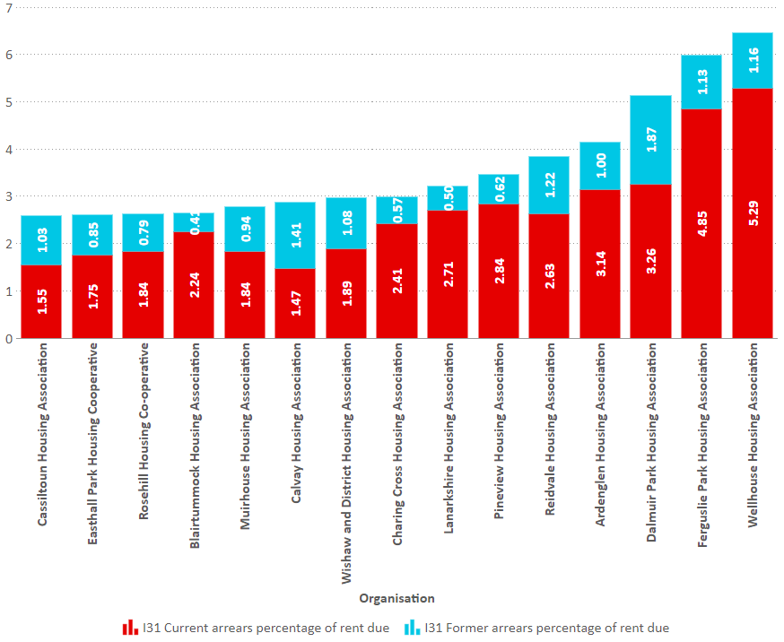
Arrears
I31: Current rent arrears (all tenants) as at 31 March each year as a percentage of rent due for the reporting year.
% | 2016/17 | 2017/18 | 2018/19
Blairtummock | 3.0 | 2.8 | 2.2
Peer Group | 2.4 | 2.4 | 2.7
RSL Average | 2.7 | 3.0 | 2.8
SHR Average | 3.3 | 3.4 | 3.6

Slide 41
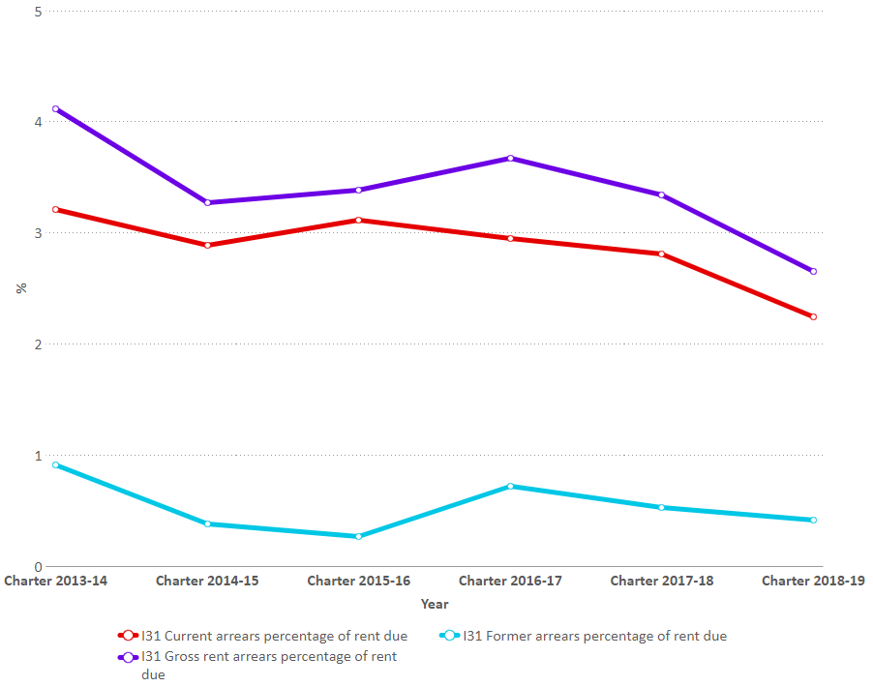
Arrears (trends)
I31: Gross Arrears trends
% | 2016/17 | 2017/18 | 2018/19
Blairtummock | 3.7 | 3.3 | 2.7
Peer Group | 3.3 | 3.6 | 3.7
RSL Average | 4.3 | 4.3 | 4.2
SHR Average | 5.3 | 5.4 | 5.7

Slide 42
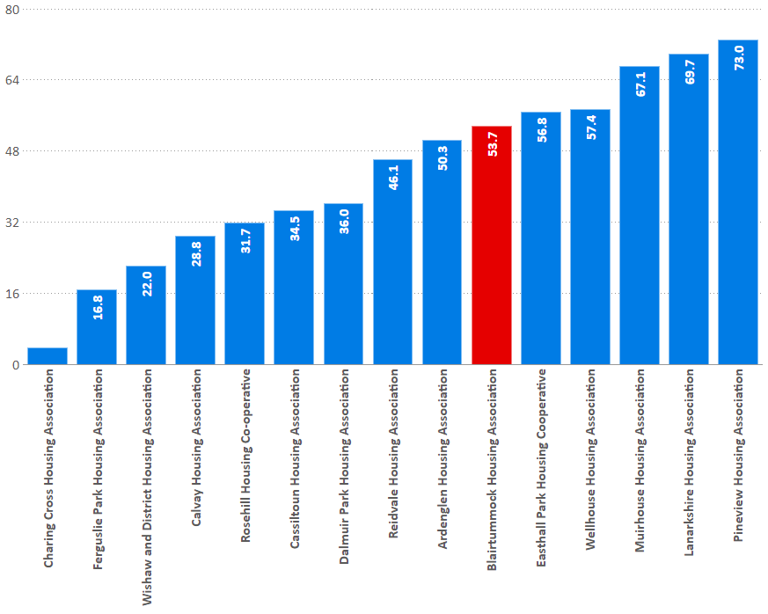
Arrears written off
C23: percentage of former tenant rent arrears written off at the year end.
% | 2016/17 | 2017/18 | 2018/19
Blairtummock | 11.1 | 43.1 | 53.7
Peer Group | 37.4 | 43.7 | 42.4
RSL Average | 44.6 | 46.8 | 45.4
SHR Average | 37.1 | 36.1 | 39.6

Slide 43
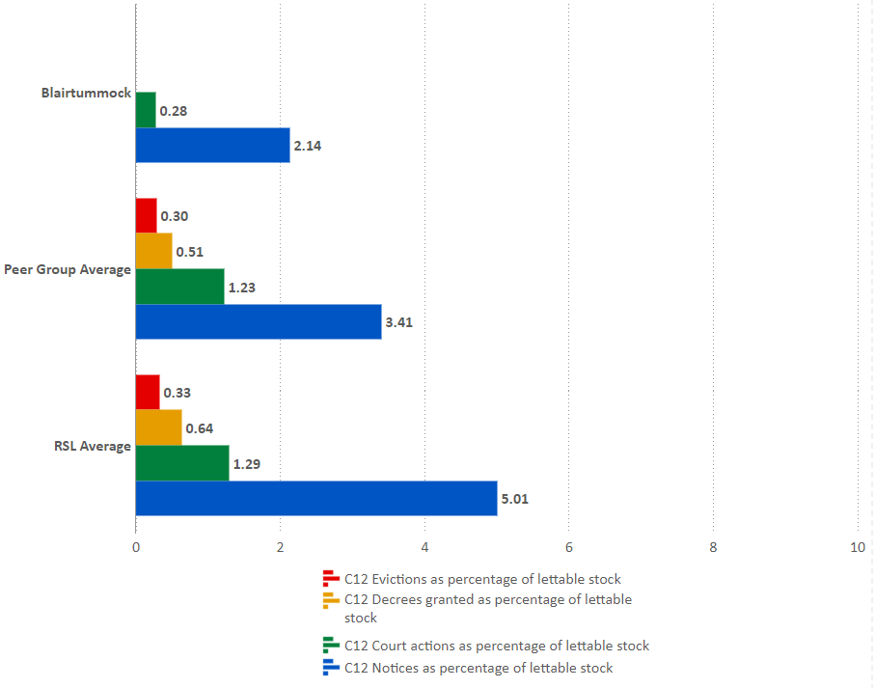
Legal action
Legal action process as a percentage of lettable stock
% | BHA | Peer Group | RSL Average
Evictions | 0 | 0.30 | 0.33
Decrees | 0 | 0.51 | 0.64
Court actions started | 0.28 | 1.23 | 1.29
NOPs | 2.14 | 3.41 | 5.01

Slide 44
Voids

Slide 45
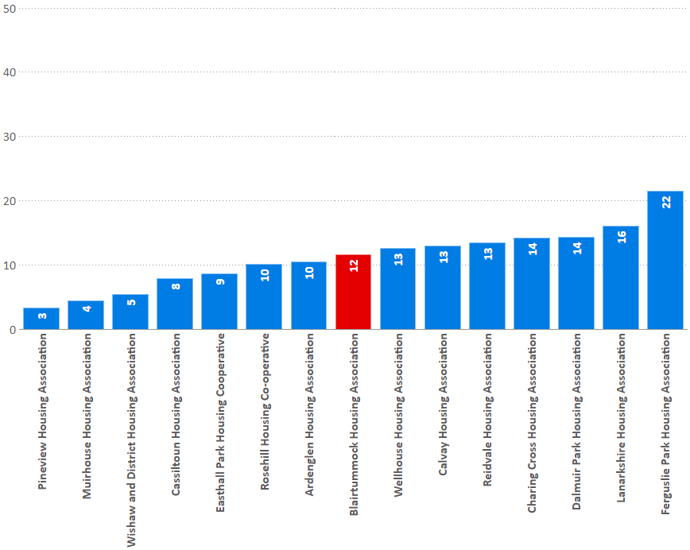
Relet times
I35: Average length of time taken to relet properties in the last year (calendar days)
% | 2016/17 | 2017/18 | 2018/19
Blairtummock | 11.3 | 14.1 | 11.6
Peer Group | 12.0 | 11.0 | 11.1
RSL Average | 28.8 | 29.0 | 29.5
SHR Average | 31.5 | 30.7 | 31.9

Slide 46
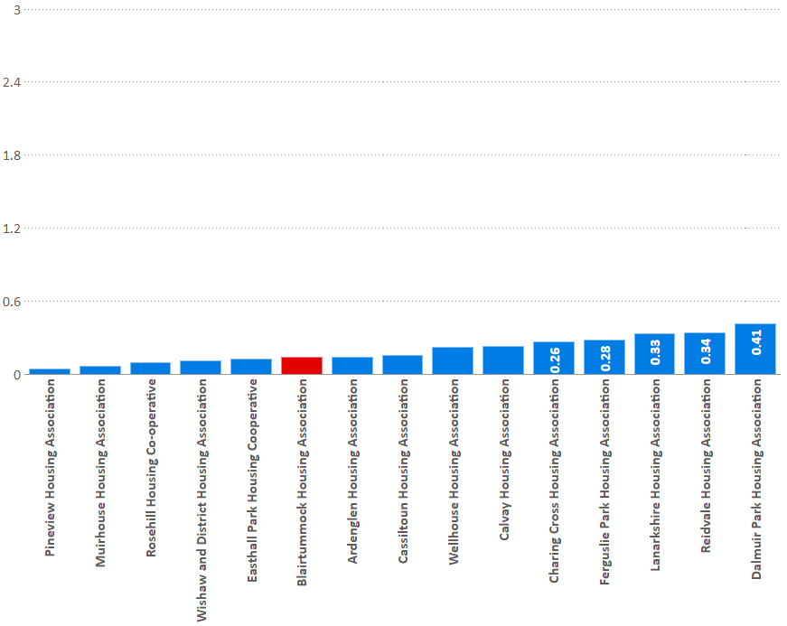
Void rent loss
I34: percentage of rent lost through properties being empty in the last year
% | 2016/17 | 2017/18 | 2018/19
Blairtummock | 0.21 | 0.14 | 0.14
Peer Group | 0.24 | 0.23 | 0.20
RSL Average | 0.89 | 0.87 | 0.88
SHR Average | 0.87 | 0.85 | 0.88

Slide 47
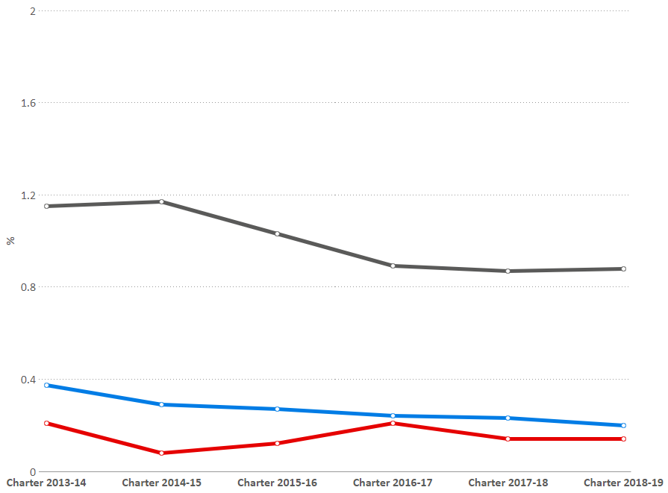
Void rent loss (trends)
I34: percentage of rent lost through properties being empty in the last year
% | 2016/17 | 2017/18 | 2018/19
Blairtummock | 0.21 | 0.14 | 0.14
Peer Group | 0.24 | 0.23 | 0.20
RSL Average | 0.89 | 0.87 | 0.88
SHR Average | 0.87 | 0.85 | 0.88

Slide 48
Landlord Report
Service
Satisfaction:
Overall
Keeping informed
Opportunities to participate
SHQS
Emergency repairs time
Non-emergency repairs time
Right first time
Appointments kept
Repairs satisfaction
ASB cases within target
Value for Money
Average weekly rent
Annual rent increase
Void relet time
Void rent loss
Rent collected
Service and Value for Money
Landlord Report Indicators

Slide 49
Landlord report
-
-
-
-
-
-
-
 | I1 Satisfied with overall service | I3 Satisfied with keeping tenants informed | I6 Satisfied with opportunities to participate | I7 Properties meeting SHQS | I11 Time taken to complete emergency repairs | I12 Time taken to complete non-emergency repairs | I13 Repairs right first time | I14 Appointments kept | I16 Satisfaction with repairs service | I19 ASB cases resolved within targets | C17 Average weekly rent | C21 Rent increase | I30 Rent collected | I34 Void rent lost | I35 Time to re-let properties
Blairtummock Housing Association | 96.97 | 99.05 | 97.16 | 100 | 2.02 | 3.52 | 96.91 | 0 | 99.7 | 100 | 71.14 | 2.5 | 99 | 0.14 | 11.58
Calvay Housing Association | 96 | 100 | 98 | 98.42 | 2.75 | 2.86 | 99.01 | 99.23 | 100 | 93.65 | 72.6 | 2.9 | 99.77 | 0.23 | 12.9
Cassiltoun Housing Association | 90.44 | 96.08 | 85.78 | 99.28 | 2.02 | 3.87 | 92.71 | 99.09 | 90.77 | 100 | 78.69 | 3.8 | 99.44 | 0.15 | 7.87
Easthall Park Housing Cooperative | 89.64 | 96.07 | 97.5 | 100 | 2.45 | 3.57 | 93.88 | 96.18 | 100 | 98.28 | 71.17 | 3.3 | 99.62 | 0.12 | 8.55
Ferguslie Park Housing Association | 89.7 | 97.27 | 98.48 | 100 | 1.88 | 5.24 | 73.8 | 0 | 90.21 | 95.24 | 83.82 | 2.4 | 99.63 | 0.28 | 21.52
Muirhouse Housing Association | 90.48 | 94.29 | 73.76 | 99.8 | 1.72 | 3.26 | 95.42 | 0 | 97.05 | 96.55 | 85.61 | 2 | 100.23 | 0.06 | 4.36
Pineview Housing Association | 92.89 | 96.23 | 97.49 | 100 | 1.72 | 2.65 | 96.13 | 96.13 | 95.03 | 100 | 76.4 | 2.36 | 98.84 | 0.04 | 3.26
Wellhouse Housing Association | 83.58 | 91.64 | 91.04 | 97.97 | 1.98 | 3.84 | 99.37 | 0 | 87.43 | 98.61 | 75.29 | 3.4 | 97.66 | 0.22 | 12.52
Wishaw and District Housing Association | 94.21 | 96.73 | 93.2 | 90.85 | 1.4 | 3.11 | 94.07 | 97.44 | 95.98 | 93.33 | 75.21 | 2.4 | 96.45 | 0.11 | 5.37

Slide 50
Summary
Service v Value for money
Comparison with Peer group
2018-19

Slide 51
Summary
Service v Value for money
Comparison with SHN Members
2018-19

Slide 52
Overall summary - 2019
Positives
Everything, especially:
EESSH (100% meeting in 2018/9)
0 evictions
low, low rent (£71.14)
very limited legal action, but still a good arrears record
Areas for concern?
23 offers refused
6 out of 35 lets to homeless

Slide 53
Forums & Services
Forums
Asset Management
Homelessness and Housing Support
Housing Management
Local Housing Strategy
Private Sector Service
Service Improvement and Scrutiny
Services
Data Collection and Management
Practice Exchange
Private Sector Service
Tools
- Value for money model
- Value for money of new build projects
Online self-assessment
Training
Enhanced Service
Data accuracy and validation services
Business Plan Review and Performance Management Service

Slide 54
Scotland’s Housing Network
First floor, 19 Haymarket Yards
Edinburgh
EH12 5BH
T: 0131 466 3710
E: info@scotlandshousingnetwork.org
W: www.scotlandshousingnetwork.org
@ScotHousingNet
facebook.com/scotlandshousingnetwork
Linkedin.com – Scotland’s Housing Network

